Slide 1

Python For Beginners
With Yousuf Alhajri

Slide 2

Whoami
Yousuf Alhajri (@D4rkness_14)
A cyber security enthusiast and a programmer
Certifications
OSCP (Offensive Security Certified Professional)
OSWE (Offensive Security Web Expert)
OSEP (Offensive Security Experienced Penetration Tester)
OSED (Offensive Security Exploit Developer)
OSCE3 (Offensive Security Certified Expert 3)

Slide 3
Before we start …
Slides can be found on following Gitlab repository
https://gitlab.com/omr00t/python-for-beginners/

Slide 4
Let’s dive in!

Slide 5
What is Python?
Python is an interpreted high-level programming language.
It is written in C.
It's designed with code readability in mind.

Slide 6
A bit of history
First released in 1991 as Python 0.9.0.
Designed by a guy named Guido Van Rossum in Netherlands.
It was supposed to be the successor of a programming language called ABC.
Named after BBC show "Monty Python’s Flying Circus".
Python 2.0 was released in 2000.
Python 3.0 was released in 2008 due to fundamental flaws in previous versions.
Python 2 was discontinued as of 2020 with latest version being 2.7.18.

Slide 7
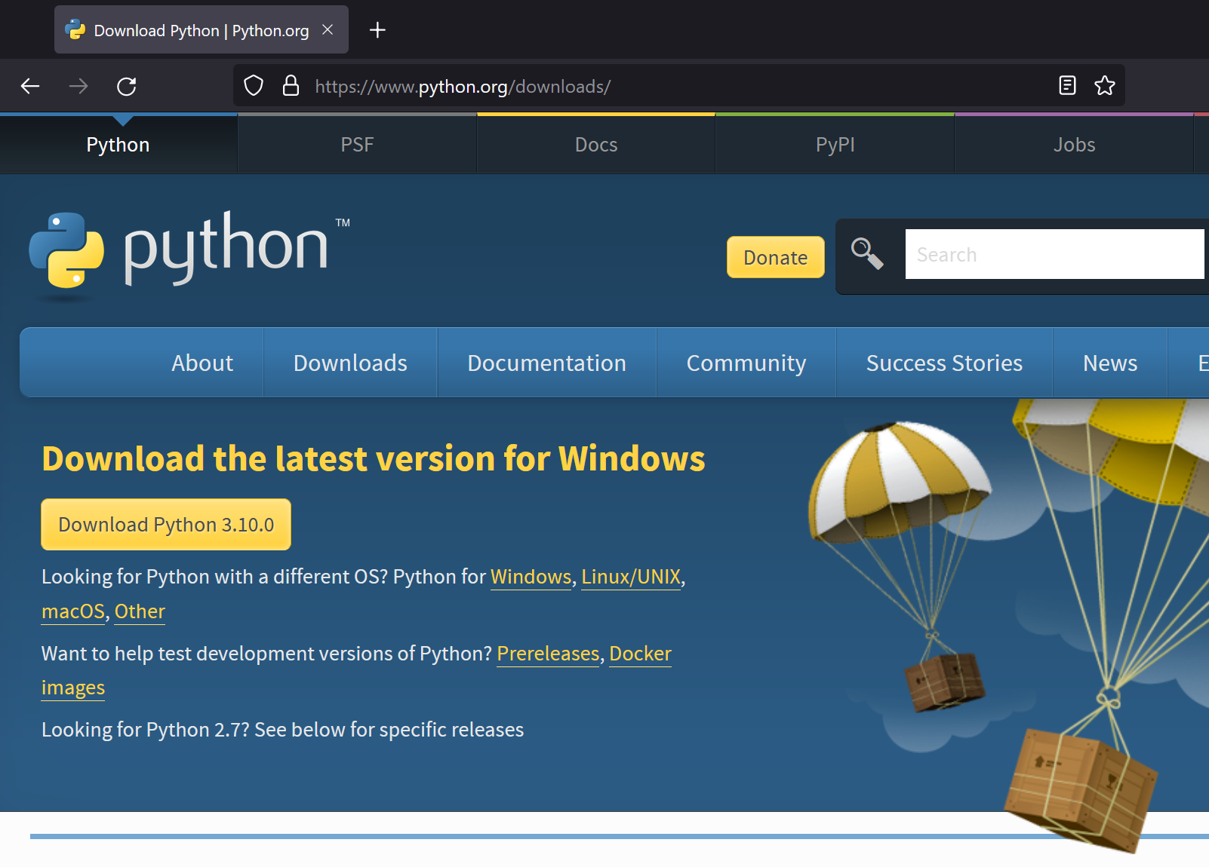
Setting up the environment for Python
Head to python.org & click on "Download Python".

Slide 8
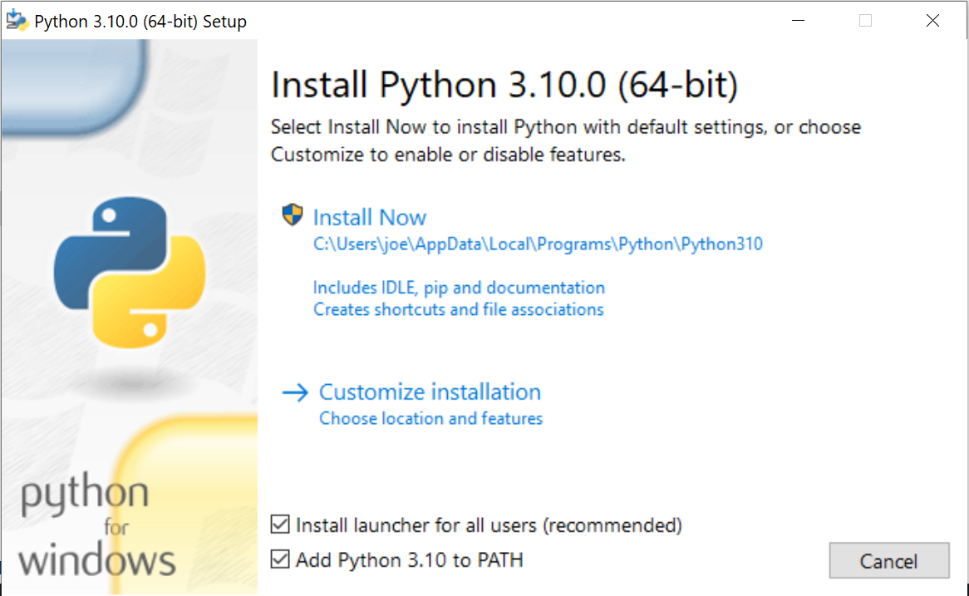

Open the installation file, make sure you click on the checkbox "Add Python 3.10 to PATH" before clicking on "Install Now".

Slide 9
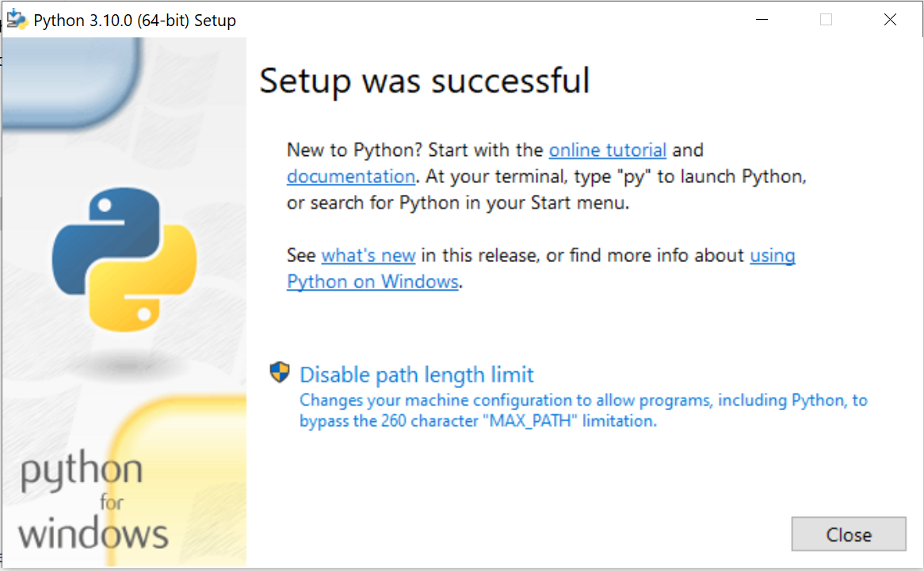
Click on the "Disable path length limit".

Slide 10
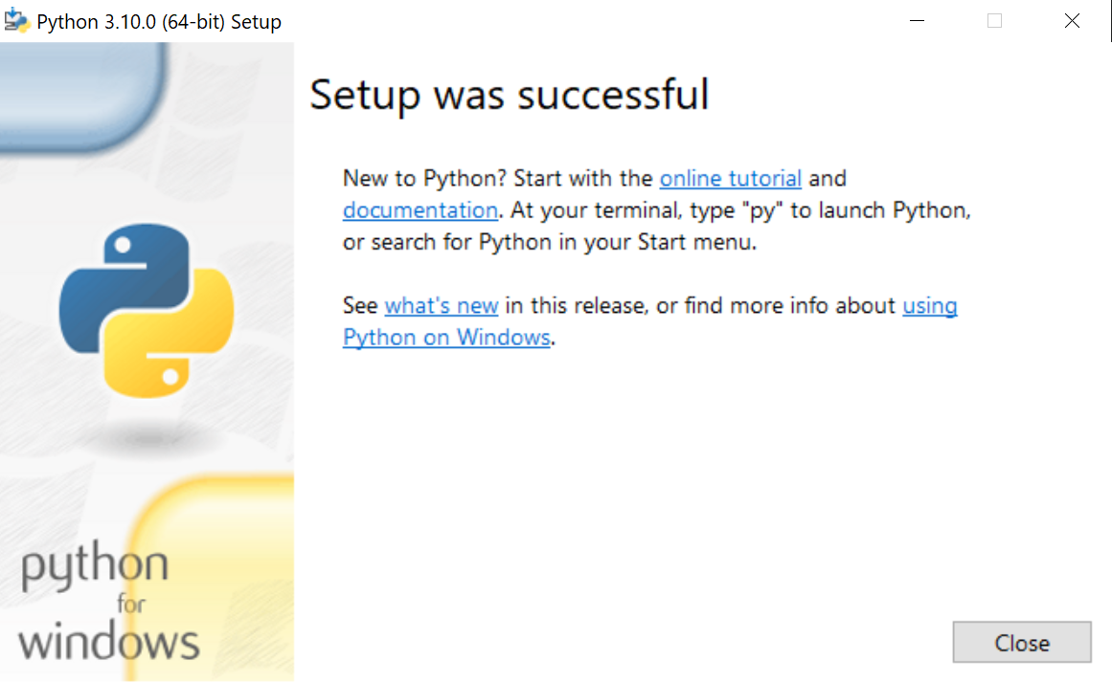
Python has been successfully installed.

Slide 11
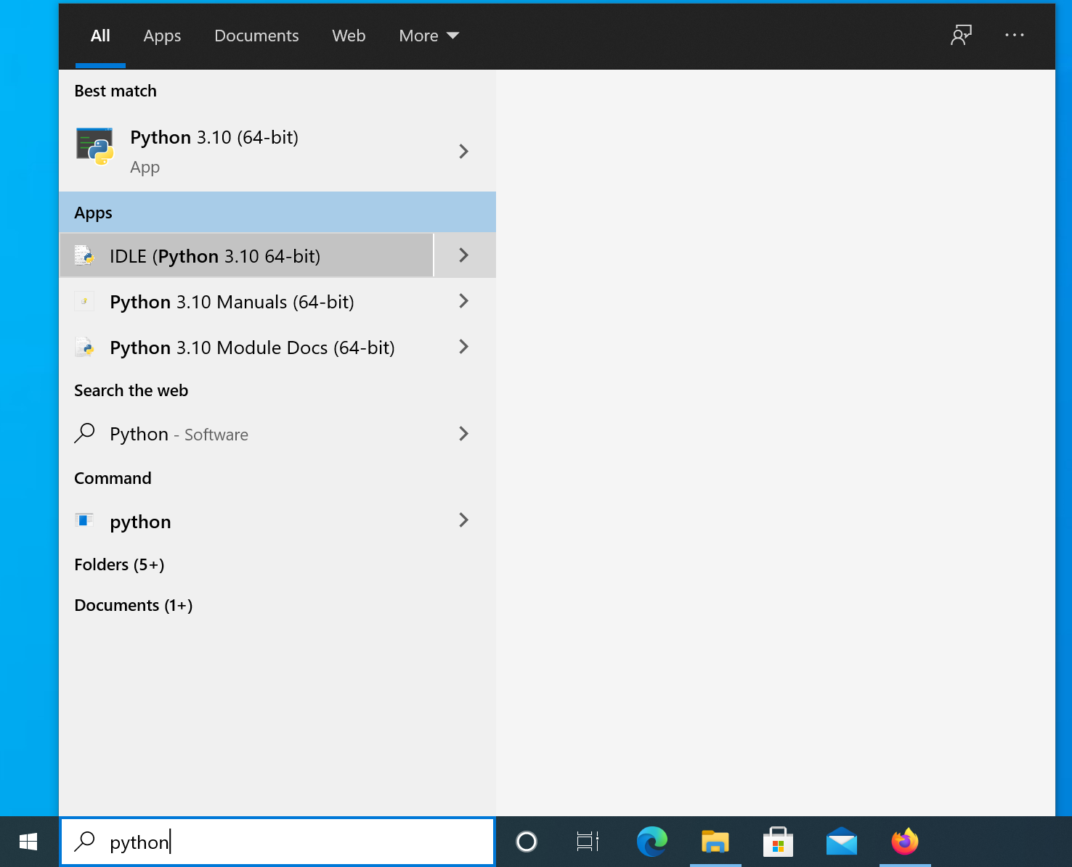
Launching Python Integrated DeveLopment Environment (IDLE) to verify successful installation.

Slide 12
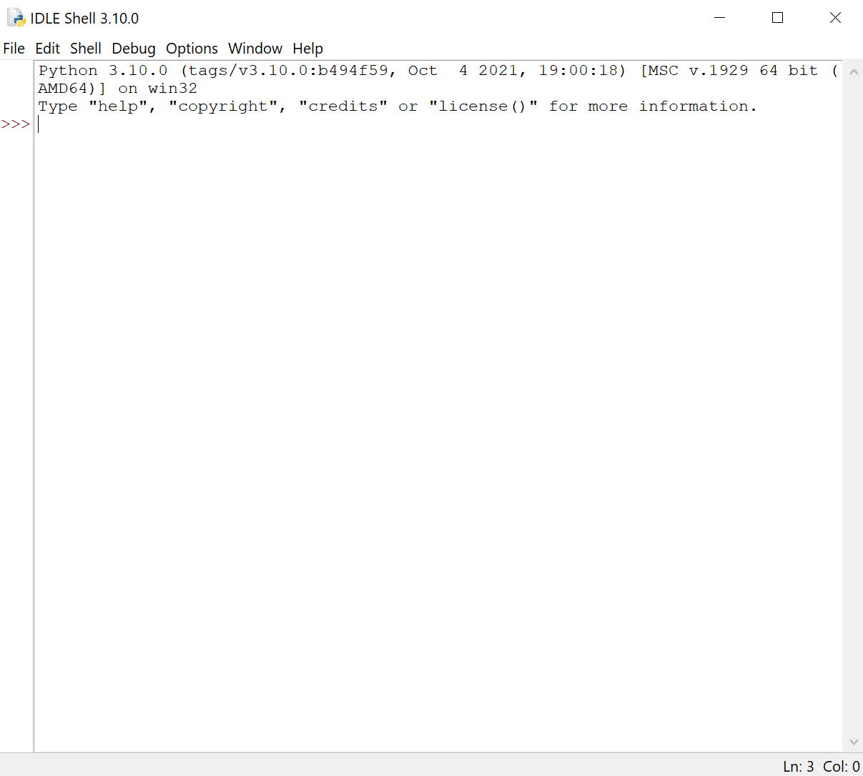
IDLE is ready!

Slide 13
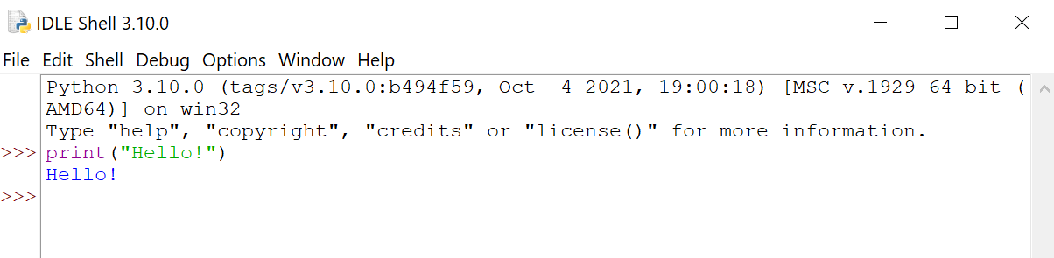
First Python program on IDLE

Slide 14
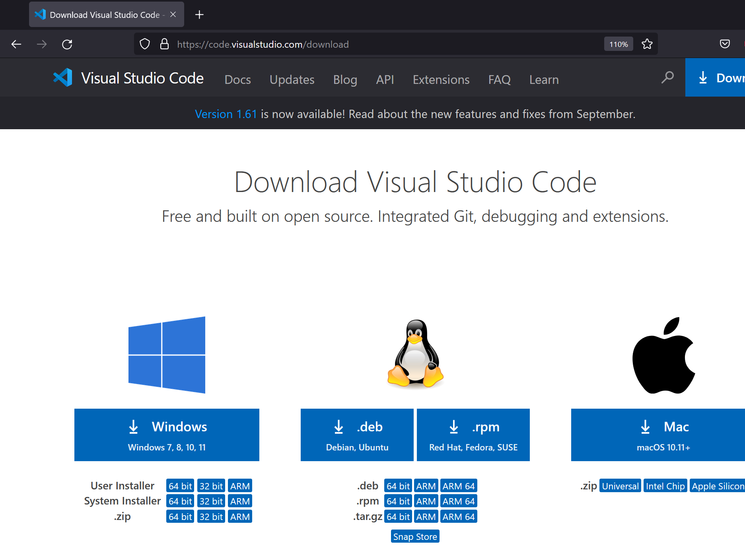
Installing VSCode
In this section, we will install VSCode.
Go to code.visualstudio.com/download

Slide 15
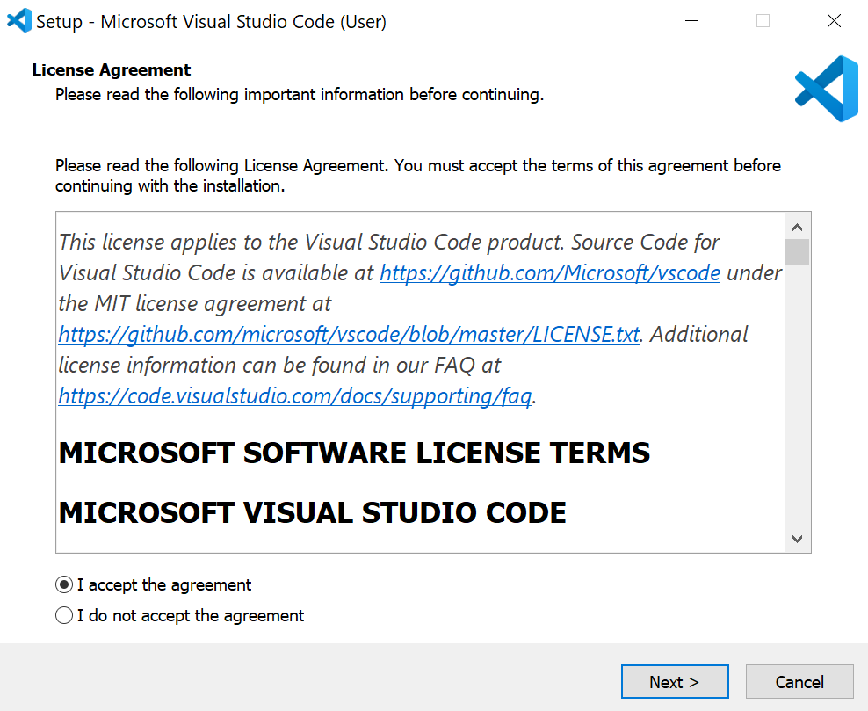
Launch the downloaded file

Slide 16
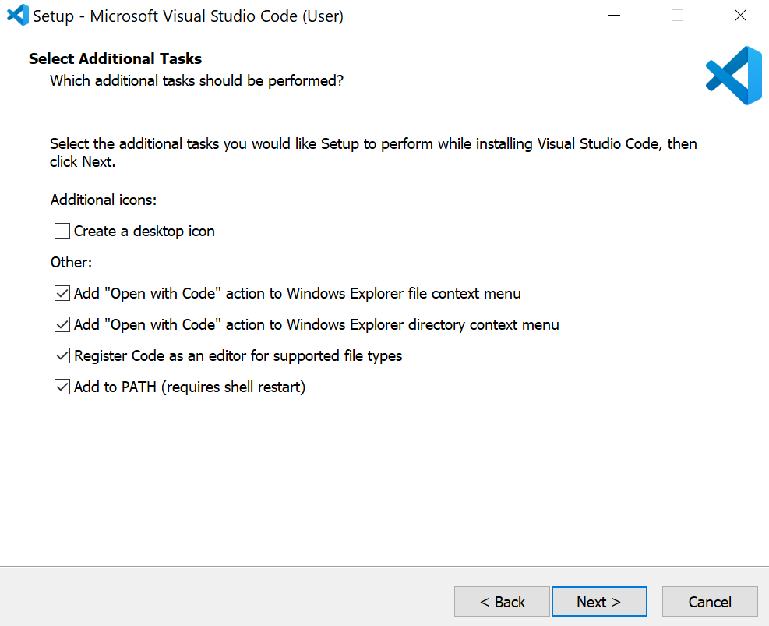
Selecting options

Slide 17
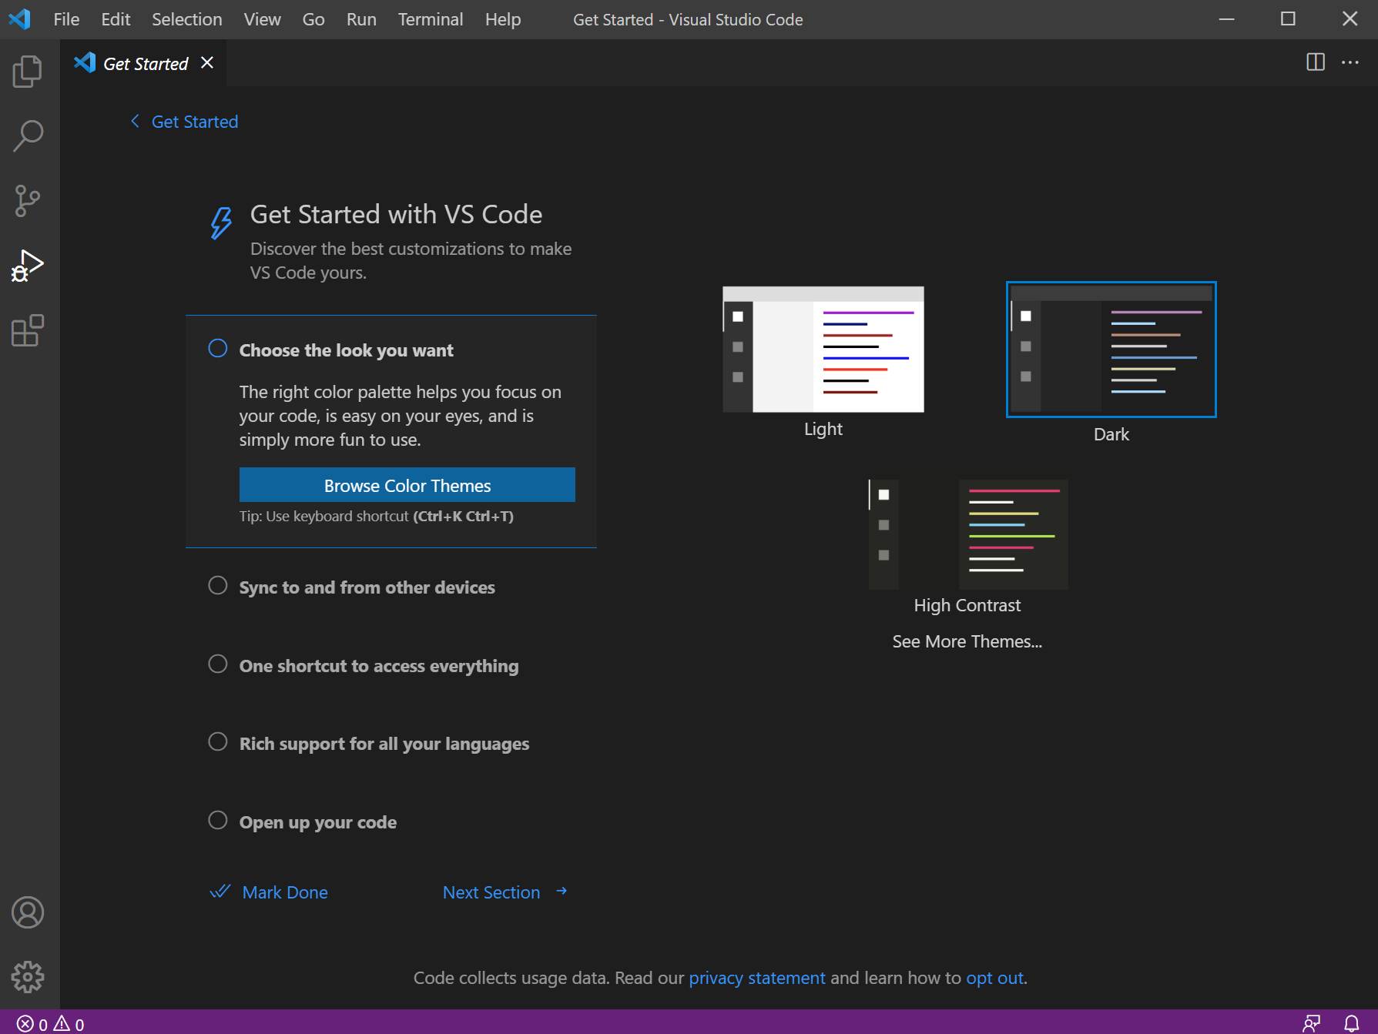
Starting VSCode

Slide 18
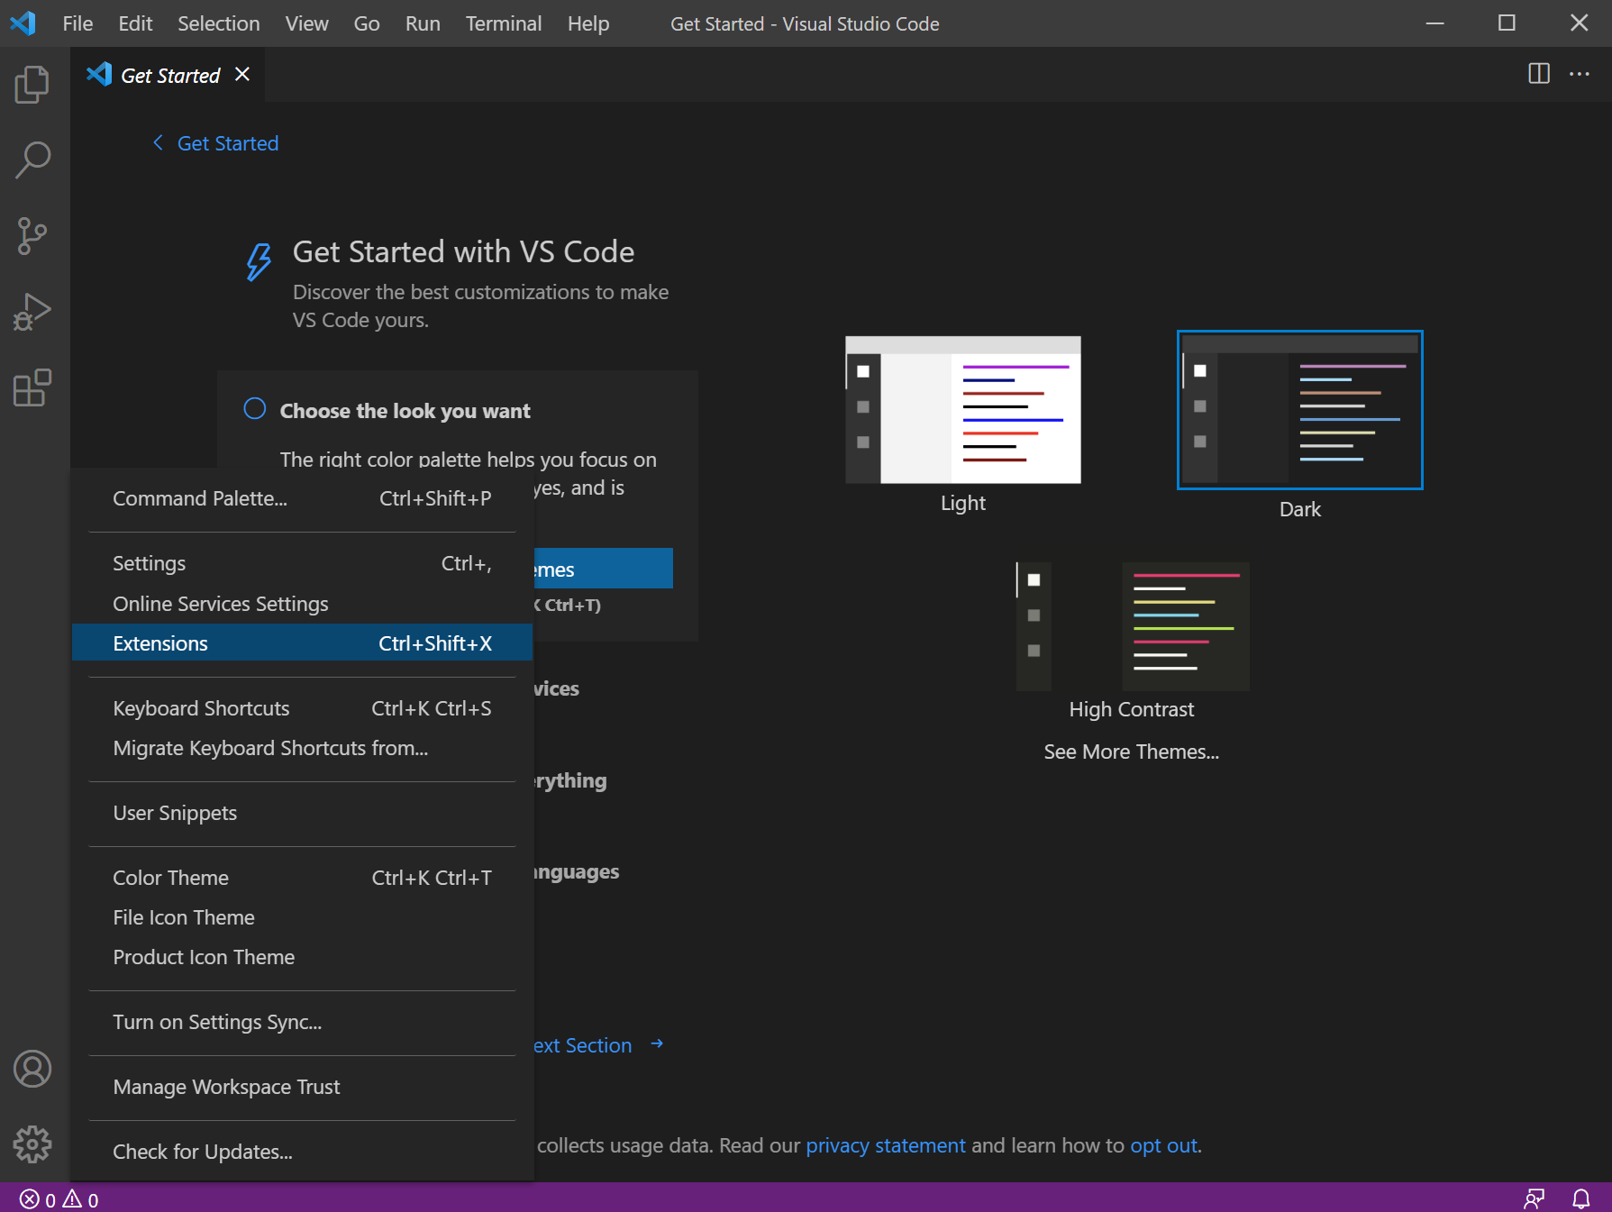
Configuring VSCode
Open the extension window

Slide 19
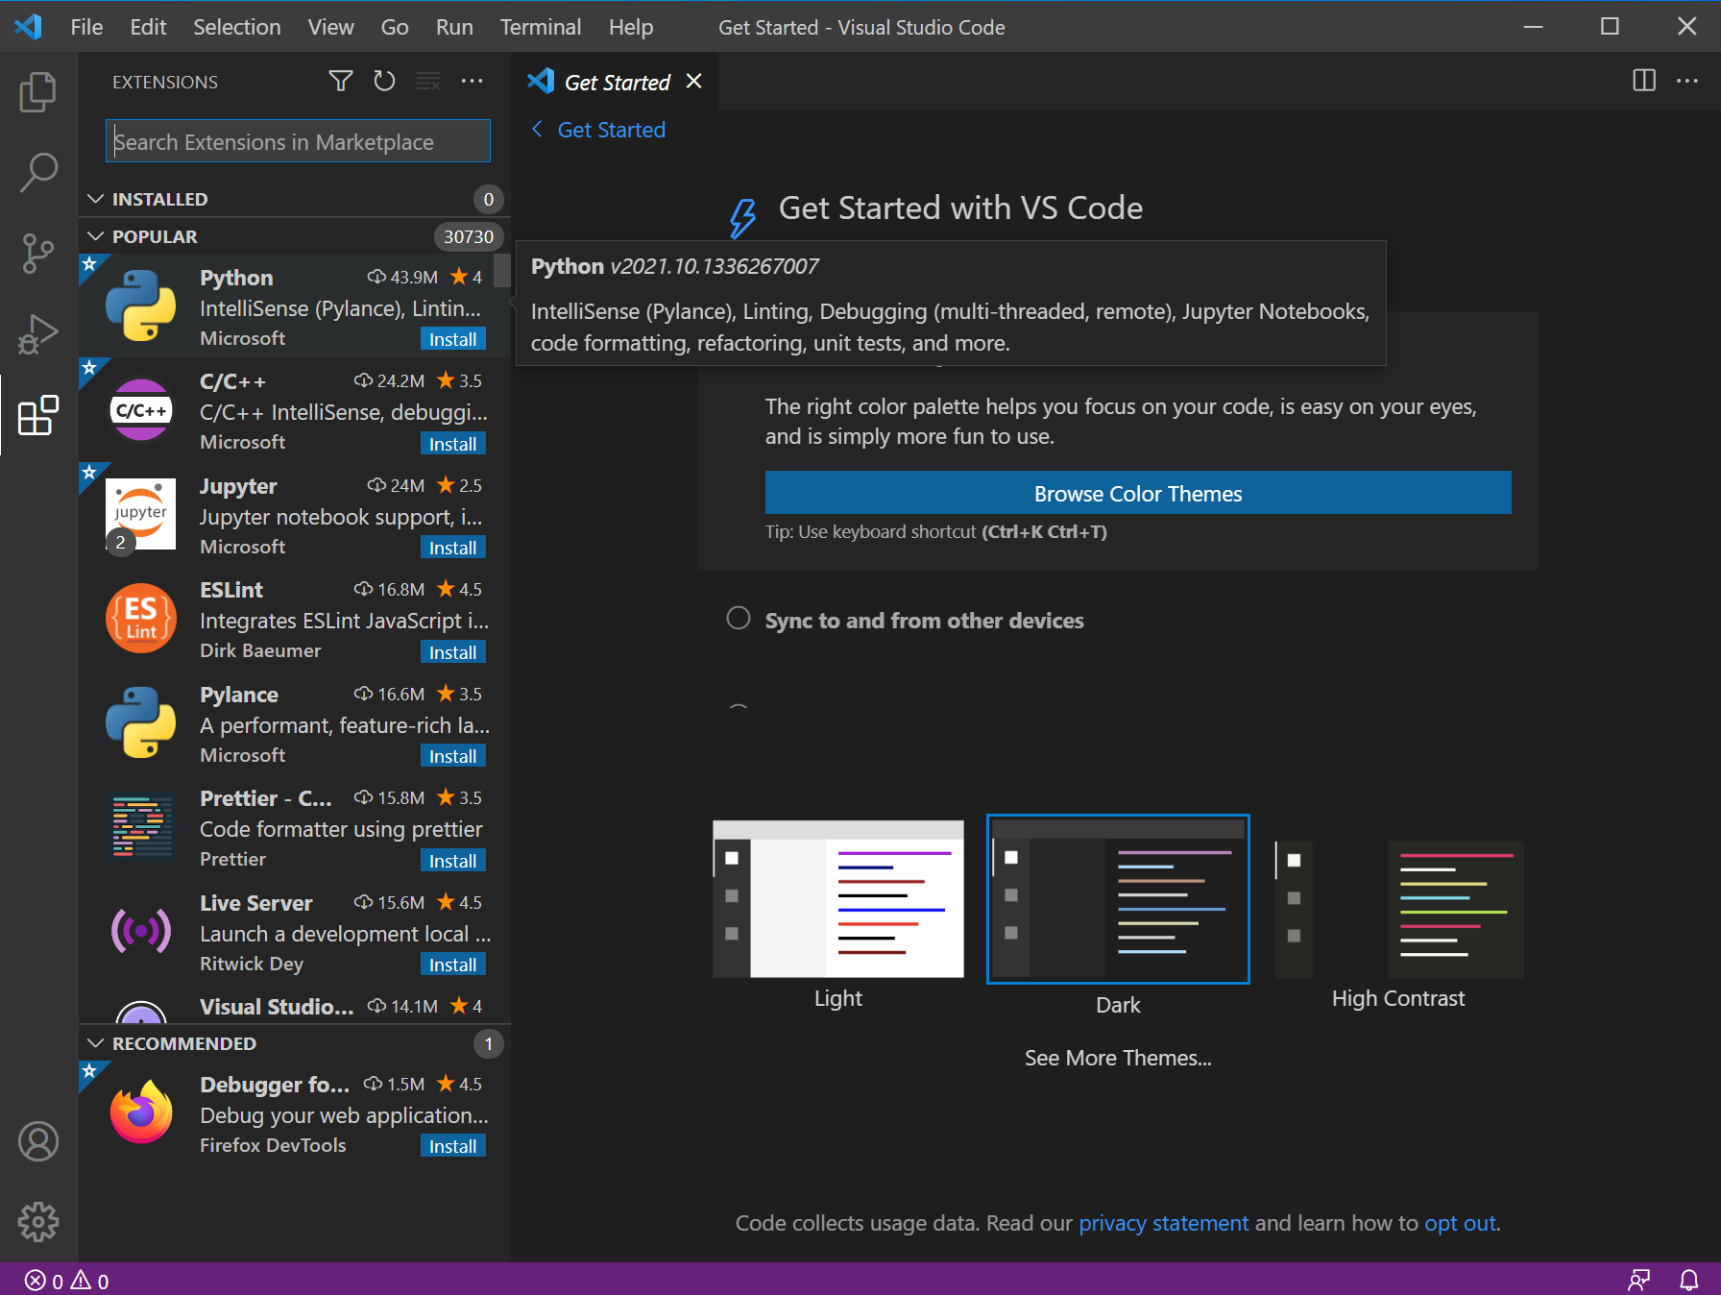
Select the Python extension and click on "install"

Slide 20
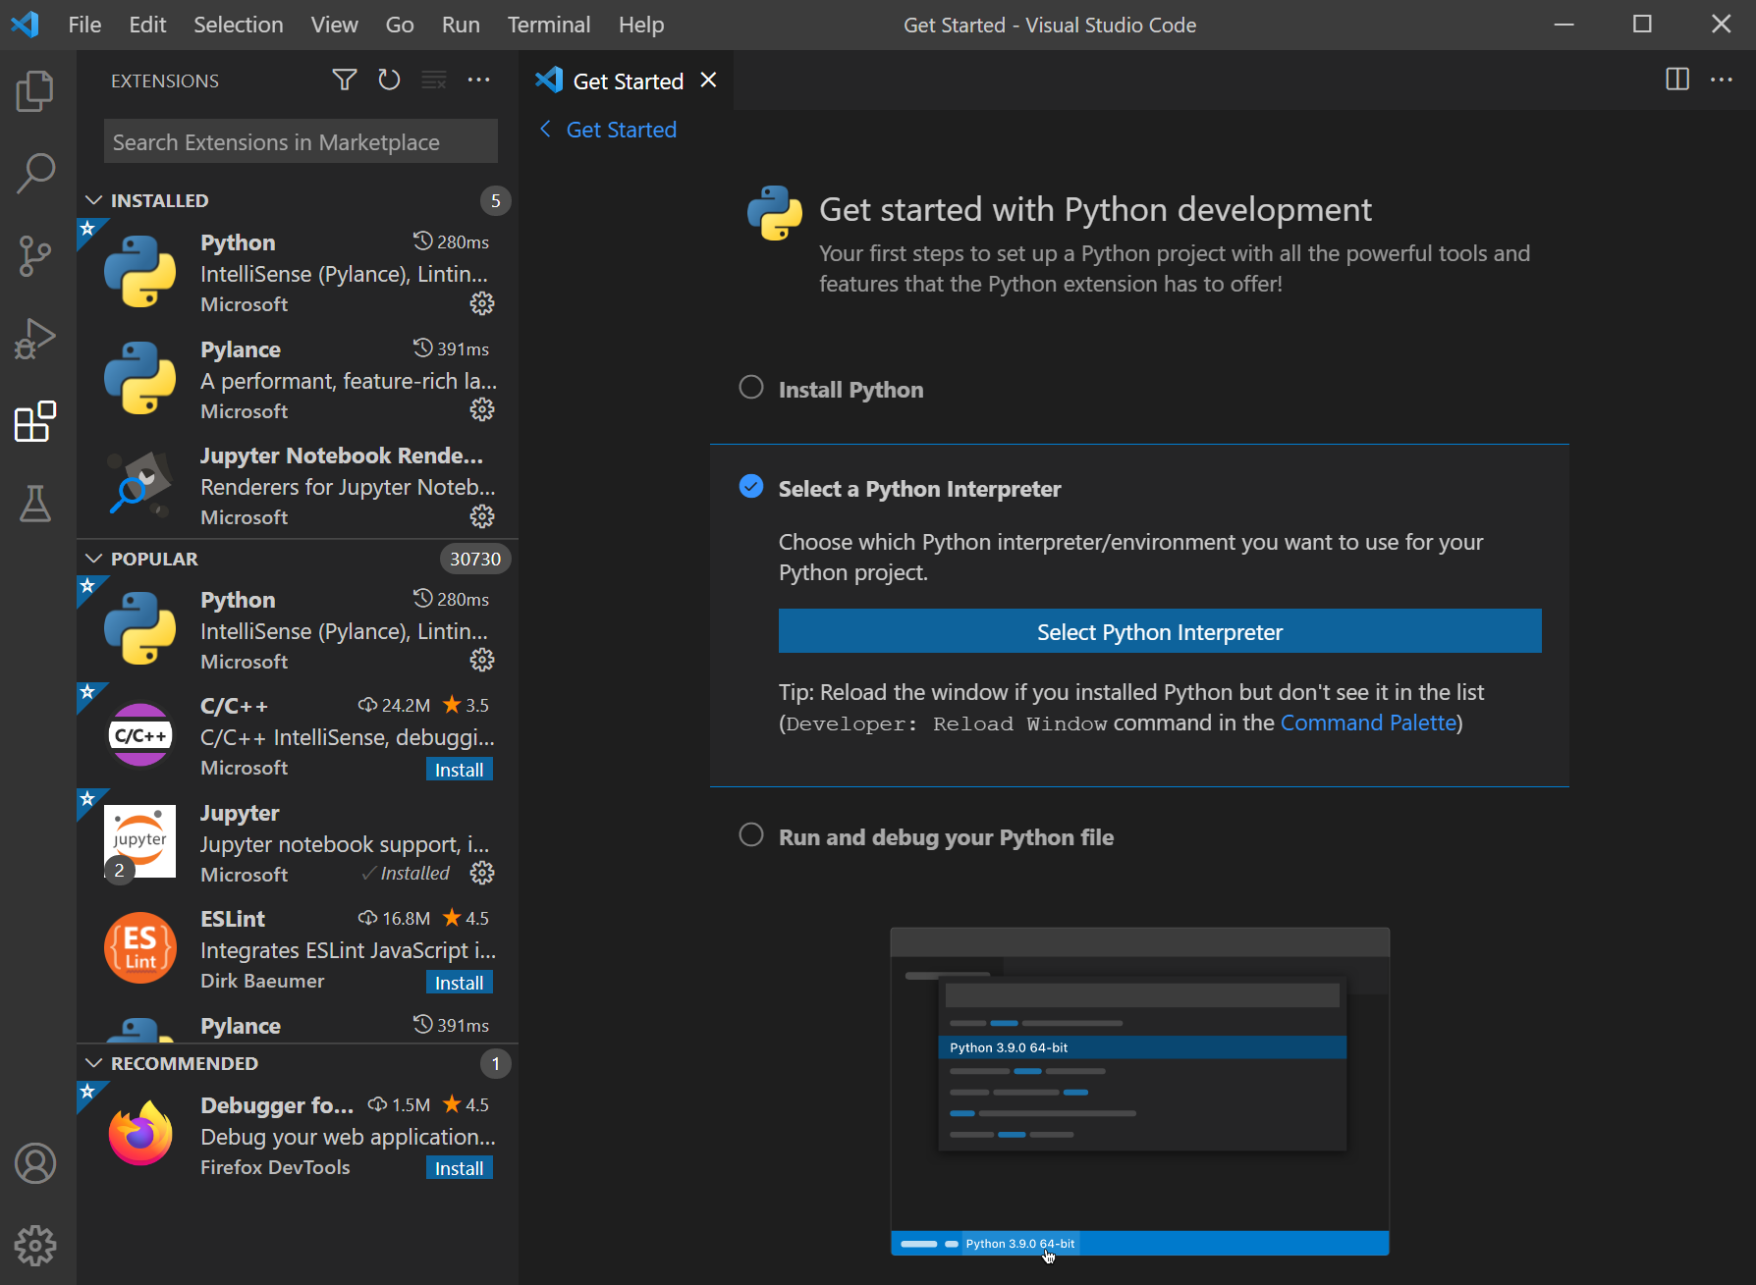
Once installed, click on the installed extension and click on "Select Python Interpreter".

Slide 21
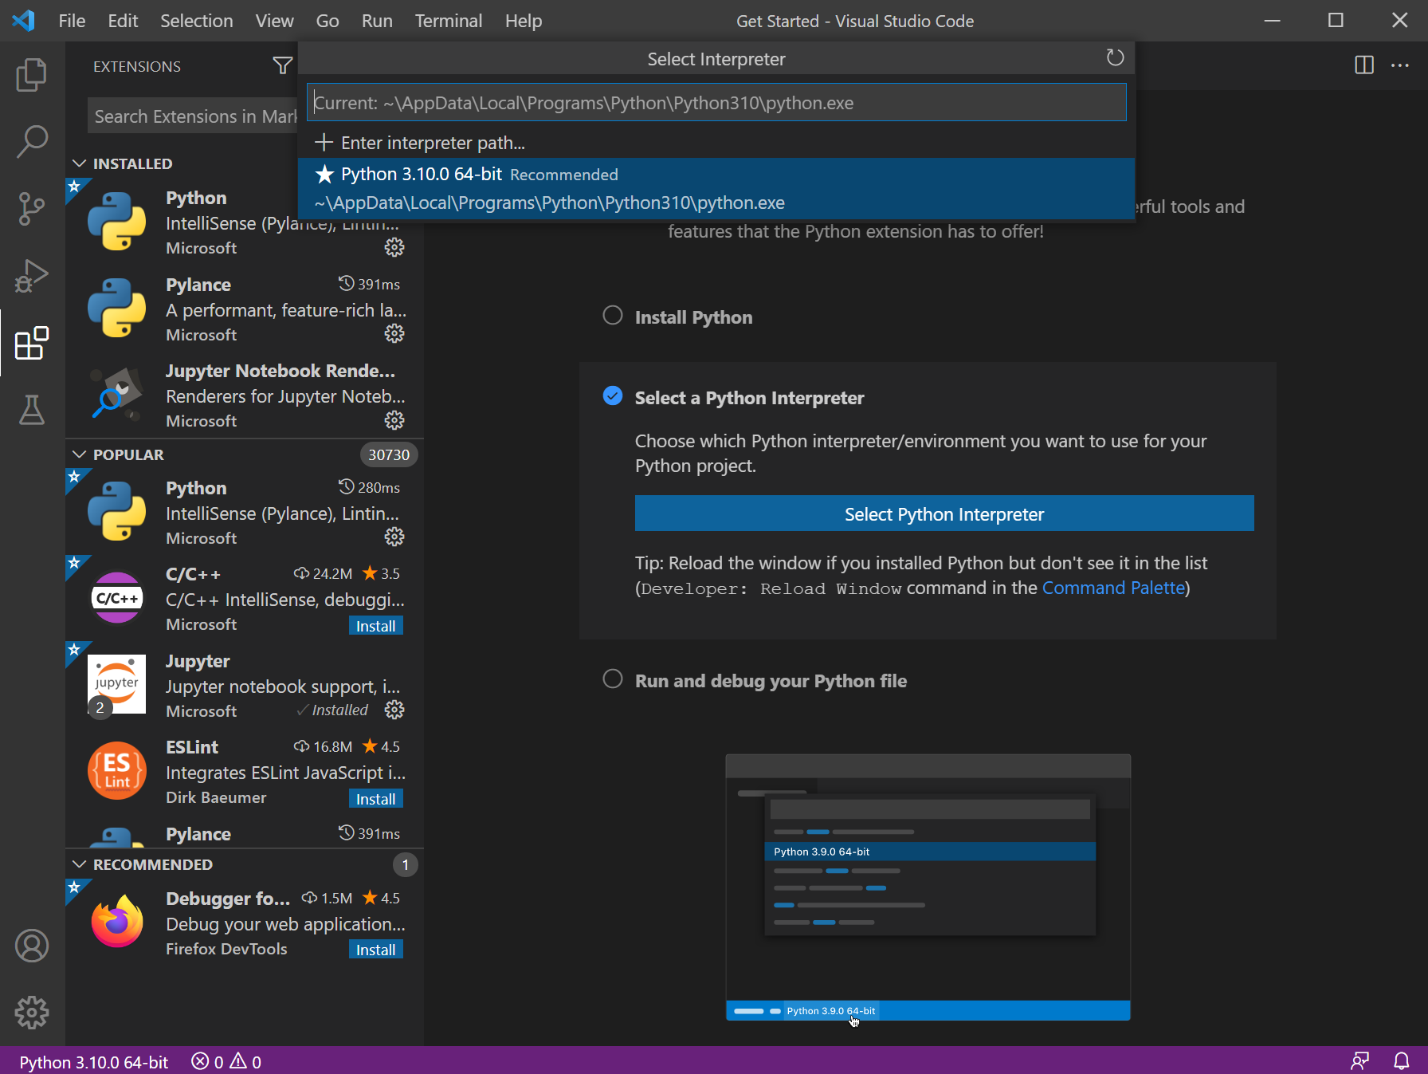
Select Python interpreter location on your computer

Slide 22
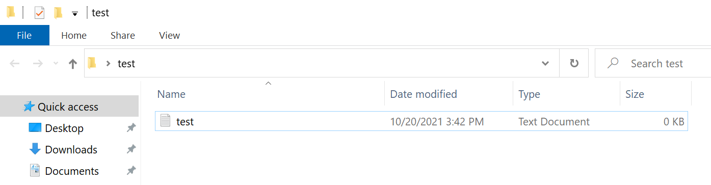
Once done, we can create a new folder called "test" and create a new text file that is also called "test"

Slide 23
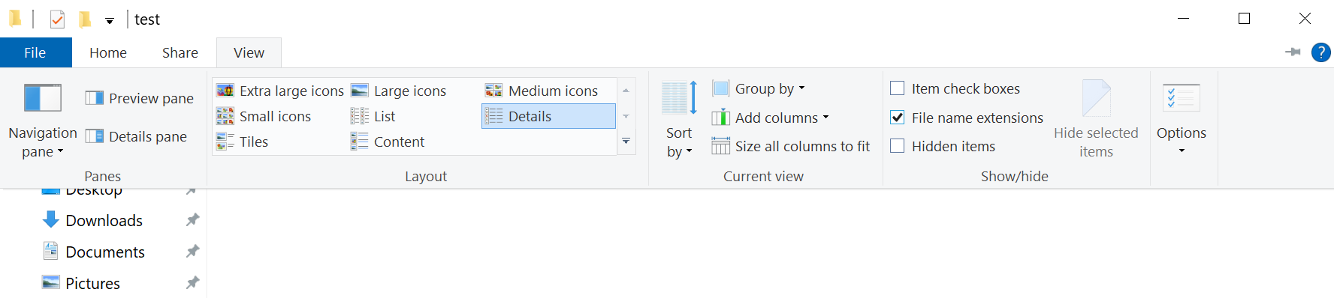
Next, click on "View" and check the "File name extensions" checkbox

Slide 24
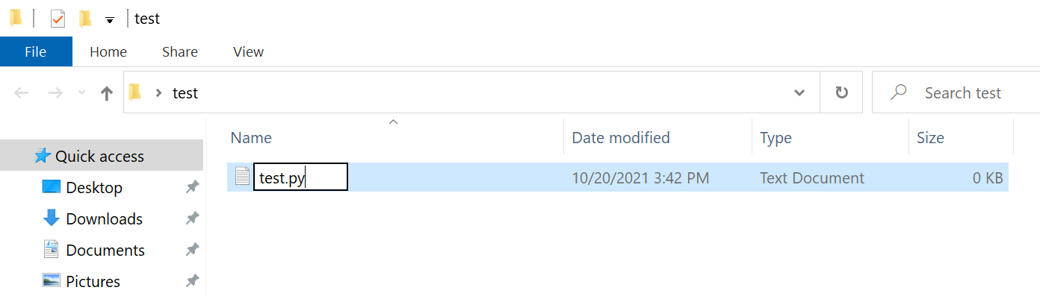
Rename the test file to “test.py”

Slide 25
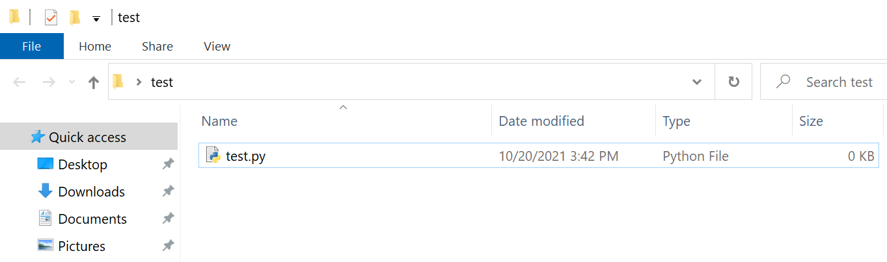
It will look like a Python file once renamed

Slide 26
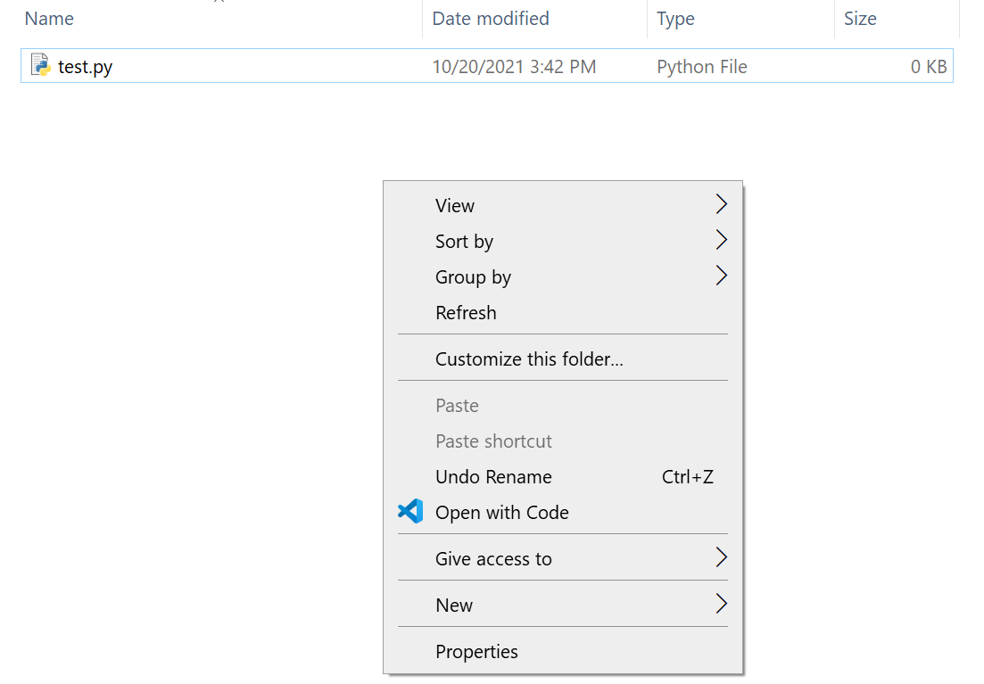
Right click on the folder and click on "Open with Code"

Slide 27
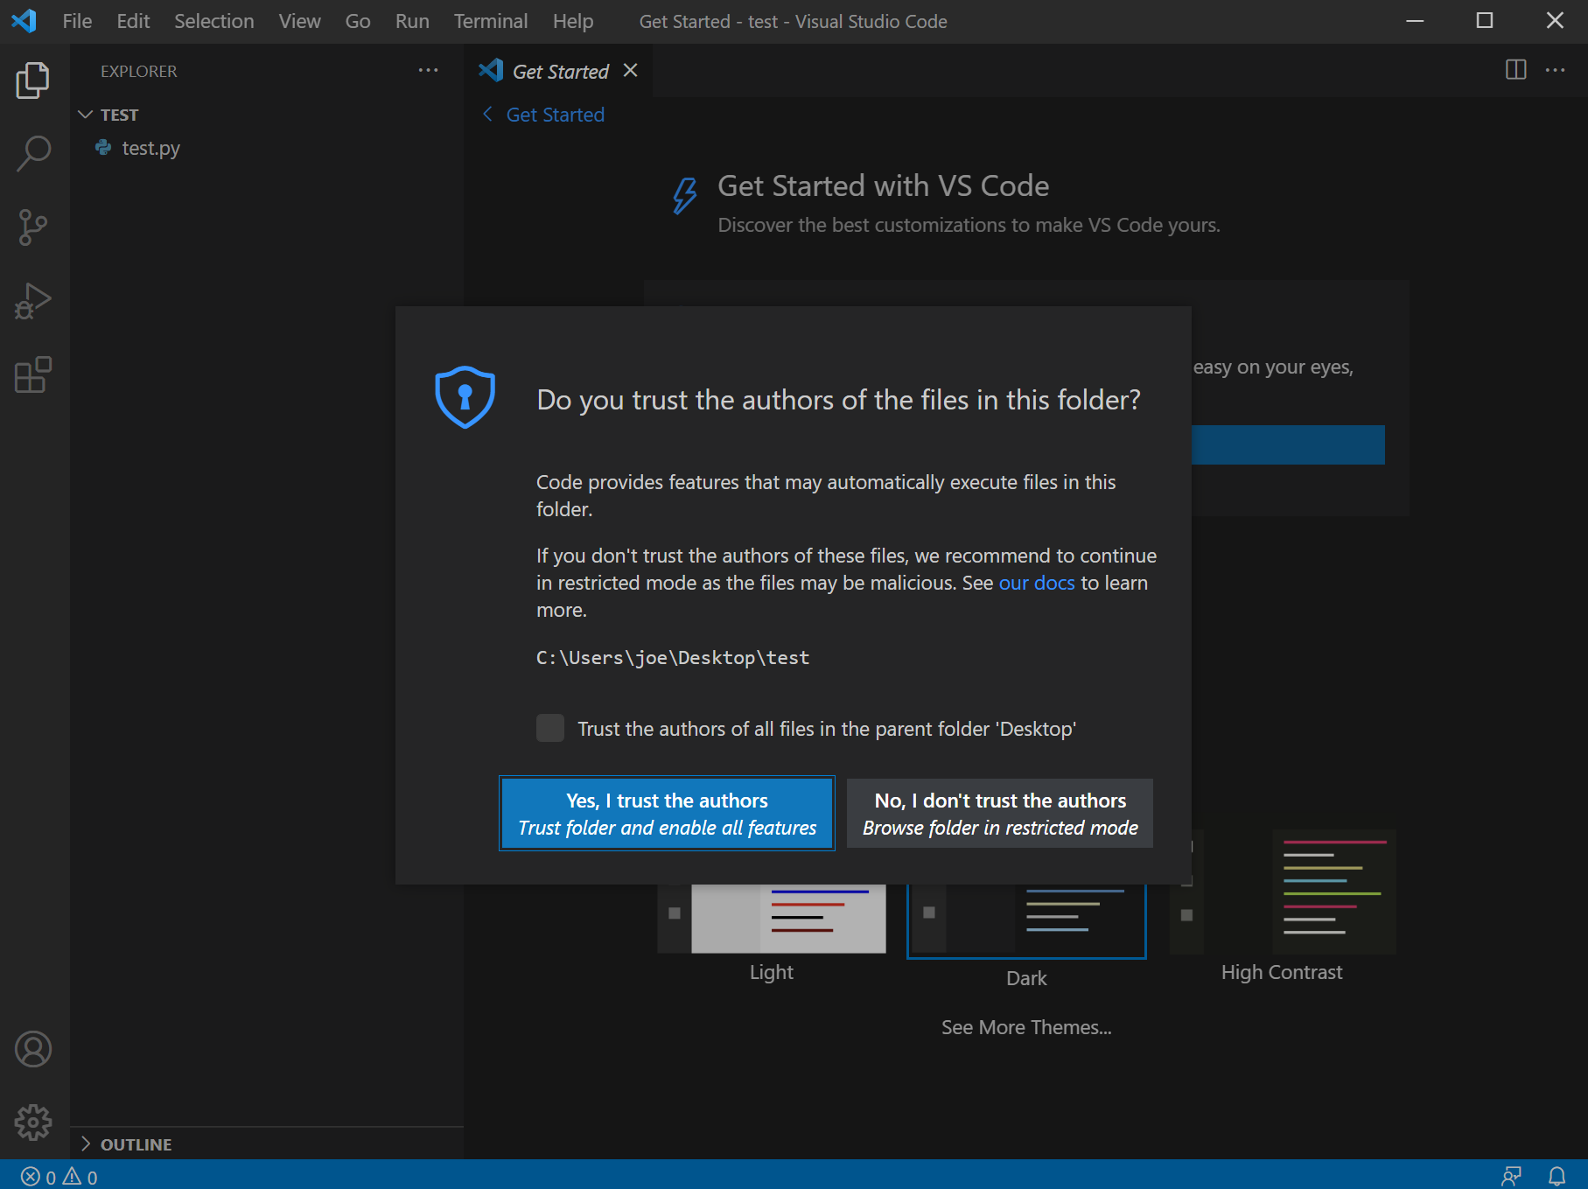
Since we created the folder ourselves, you can click on "Yes, I trust the authors"

Slide 28
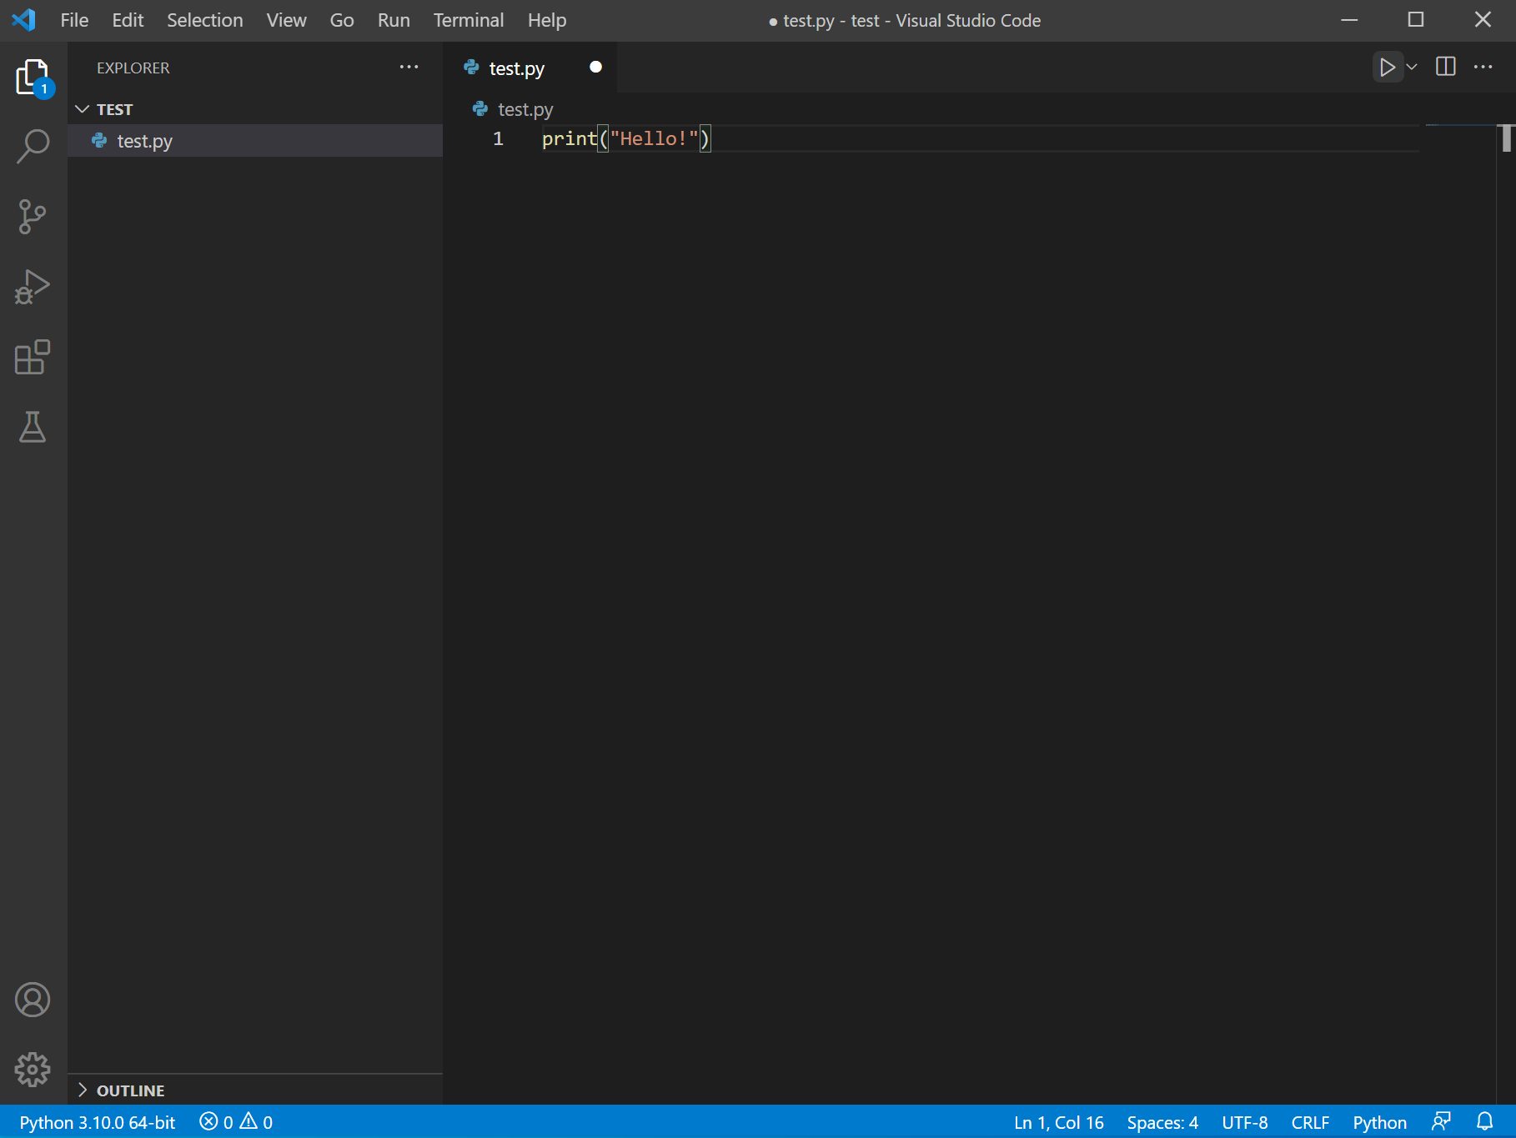
Next, we can write the following statement on the “test.py” file:
print("Hello!")

Slide 29
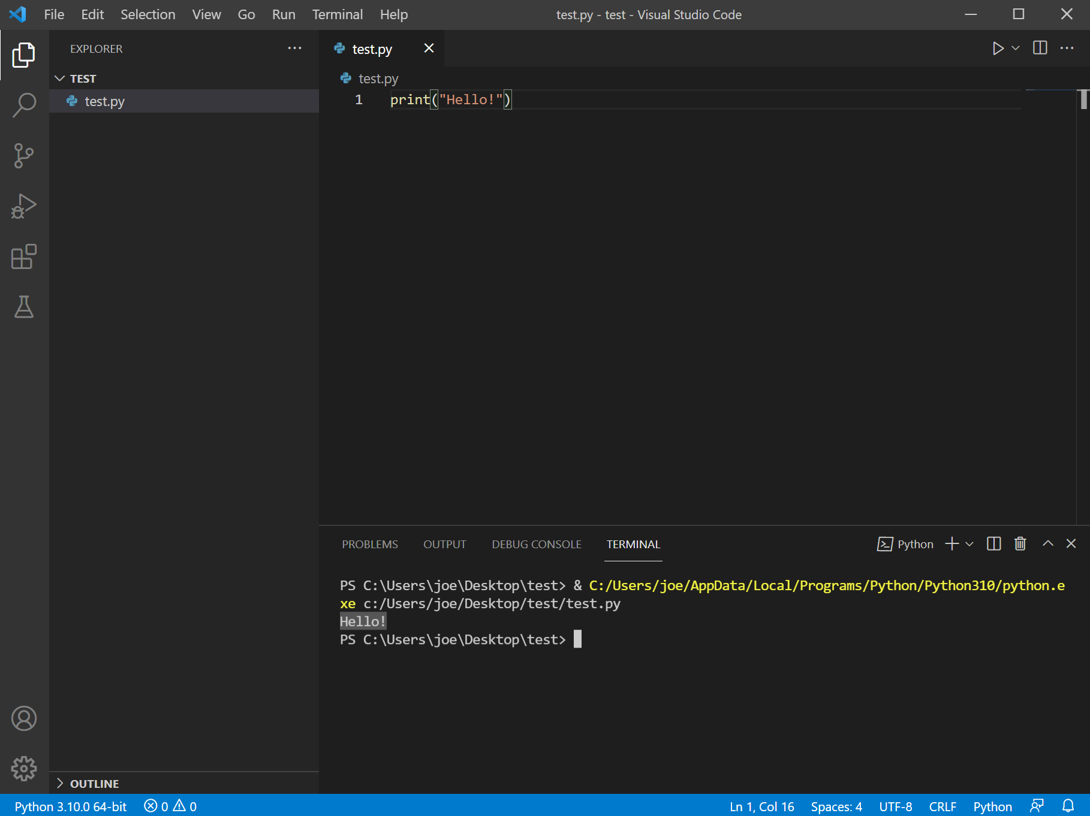
Next, you can click on “Play” button located in the upper right corner

Slide 30
Now we’re ready to start learning Python!
Before we do though, we need to note that when there’s a >>> in an example code, it means that the code is run directly on the interactive interpreter.
Otherwise, it’ll be run as a script on a single file as we’ve seen.
>>> print("Hello")
Run through the Interactive interpreter
print("Hello")
Run as a single file on VSCode

Slide 31
Getting started
Playing with Python interpreter
Comments can be defined with # as follows
>>> # Hello, I'm just a comment :)
>>> # Comments help you document your code.
>>>

Slide 32
Variables
You define variables with the assignment operator =
You don’t need to indicate the variable type
>>> a = 5
>>> b = 8.5
>>> name = "Yousuf"

Slide 33
Numbers
Types of numbers:
Integers (int): 5, 8, 10, 5129, …
Float (float): 1.8, 9.50, 103.8001, 3102.818234, …
Complex: 2+3j, …

Slide 34
Arithmetic operators
Addition (+)
Subtraction (-)
>>> 4 + 2
6
>>> 8 + 8
16
>>> 4 - 2
2
>>> 8 - 8
0
Multiplication (*)
Division (/)
>>> 8*5
40
>>> 4*(5-2)
12
>>> (7-2)*(5+4)
45
>>> 10/2 # returns a float
5.0
>>> 5/2 # returns a float
2.5
>>> 5//2 # returns an integer
2

Slide 35
Arithmetic operators (cont.)
Modulo (%)
Exponent (**)
>>> 5%2
1
>>> 12%3
0
>>> 2%3
2
>>> 15%4
3
>>> 5**2 # 5 to the power of 2 = 5*5
25
>>> 6**3 # 6 to the power of 3 = 6*6*6
216
>>> 10**10 # 10 to the power of 10 = 10*10*10*10*10*…
10000000000

Slide 36
Integer representations
Binary (b)
Octal (o)
Hexadecimal (x)
>>> 0b01
1
>>> 0b10
2
>>> 0b11
3
>>> 0b100
4
>>> 0o7
7
>>> 0o10
8
>>> 0o17
15
>>> 0o20
16
>>> 0x5
5
>>> 0xf
15
>>> 0x10
16
>>> 0xff
255

Slide 37
Large numbers
>>> 3600050 - 350
3599700
>>> 3_600_050 - 350
3599700
>>>
>>> 100000000 + 500000
100500000
>>> 100_000_000 + 500_000
100500000

Slide 38
Large numbers (cont.)
Python supports very large numbers
>>> a = 999999999999999999999999999999999999999999999999999999999999999999999999999999999999999999999
>>> b = 888888888888888888888888888888888888888888888888888888888888888888888888888888888888888888888
>>> c = a - b
>>> c
111111111111111111111111111111111111111111111111111111111111111111111111111111111111111111111

Slide 39
Scientific notations
Exponents can be expressed with “e”
>>> 2e10
20000000000.0
>>> 4.21e5
421000.0
>>> 9.4192e3
9419.2
>>> 3.2e-1
0.32
>>> 0.4192e-2
0.004192
>>> 1.33315e-5
1.33315e-05

Slide 40
Numbers playground
>>> a = 2
>>> b = 3.5
>>> c = a*b
>>> c
7.0
>>> c * 3
21.0
>>> d = _ / 7 # _ means the result of the previous operation
>>> d
3.0

Slide 41
Numbers playground (cont.)
>>> a = 0xf # 15 in decimal
>>> b = 0b101 # 5 in decimal
>>> c = 0o10 # 8 in decimal
>>> d = a * b * c
>>> d
600

Slide 42
Numbers playground (cont.)
>>> 5 * 8 - 6
34
>>> 5 * (8 - 6)
10
>>> 2**3 * 2 - 1
15
>>> 2**3 * (2 - 1)
8
>>> -2**2
-4
>>> (-2)**2
4

Slide 43
Bitwise operators
& (Bitwise AND)
| (Bitwise OR)
>>> # 7 is 0111 in binary
>>> # 10 is 1010 in binary
>>> 7 & 10
2
>>> # 2 is 0010 in binary
>>> # 7 is 0111 in binary
>>> # 10 is 1010 in binary
>>> 7 | 10
15
>>> # 15 is 1111 in binary
~ (Bitwise NOT)
>>> # 7 is 0111 in binary
>>> ~7 & 0xf # ANDing it with 0xf to discard higher bits.
8
>>> # 8 is 1000 in binary.

Slide 44
Bitwise operators (cont.)
^ (Bitwise XOR)
>> (Bitwise right shift)
<< (Bitwise left shift)
>>> # 7 is 0111 in binary
>>> # 10 is 1010 in binary
>>> 7 ^ 10
13
>>> # 13 is 1101 in binary
>>> # 7 is 0111 in binary
>>> 7 >> 1
3
>>> # 3 is 0011 in binary
>>> 7 >> 2
1
>>> # 1 is 0001 in binary
>>> # 7 is 0111 in binary
>>> 7 << 1
14
>>> # 14 is 1110 in binary
>>> 7 << 2
28
>>> # 28 is 11100 in binary

Slide 45
Other assignment operators
Any arithmetic or bitwise operator can be combined with = to alter a value of a variable.
>>> x = 2
>>> x += 4 # x = x + 4
>>> x
6
>>> x //= 2 # x = x // 2
>>> x
3
>>> x <<= 2 # x = x << 2
>>> x
12

Slide 46
Boolean
Boolean variables refer to the variables that take either True or False. Notice that the initial letter is a capital letter.
>>> a = True
>>> b = False

Slide 47
Logical operators
and
or
not
>>> a = True
>>> b = False
>>> a and b
False
>>> a = True
>>> b = False
>>> a or b
True
>>> a = True
>>> b = False
>>> not a
False
>>> not b
True
>>> a and not b
True

Slide 48
Comparison Operators
> (larger than)
< (less than)
== (equality)
>>> 2 > 3
False
>>> 3 > 2
True
>>> 3 > 3
False
>>> 2 < 3
True
>>> 3 < 2
False
>>> 3 < 3
False
>>> 2 == 3
False
>>> 3 == 2
False
>>> 3 == 3
True

Slide 49
Comparison Operators (cont.)
!= (not equal)
>= (larger or equal)
<= (less or equal)
>>> 2 != 3
True
>>> 3 != 2
True
>>> 3 != 3
False
>>> 2 >= 3
False
>>> 3 >= 2
True
>>> 3 >= 3
True
>>> 2 <= 3
True
>>> 3 <= 2
False
>>> 3 <= 3
True

Slide 50
Strings
>>> "I like Winter"
'I like Winter'
>>> 'I don\'t like Summer'
"I don't like Summer"
>>> phrase = "In Python, you have to enclose your strings with either \" or '."
>>> print(phrase)
In Python, you have to enclose your strings with either " or '.
>>> print('My mother doesn\'t like Winter')
My mother doesn't like Winter

Slide 51
Strings (cont.)
>>> print("The file is located at C:\test\nasser\test.txt")
The file is located at C: est
asser est.txt
>>> # \t means a tab
>>> # \n means a newline
>>> print(r"The file is located at C:\test\nasser\test.txt") # raw
The file is located at C:\test\nasser\test.txt

Slide 52
Strings (cont.)
>>> print("""\
... You can span your string through multiple lines
... using triple-quotes.
... """)
You can span your string through multiple lines
using triple-quotes.

Slide 53
Strings (cont.)
>>> "Hello" + " " + "my friend!"
'Hello my friend!'
>>> "Hello"*4
'HelloHelloHelloHello'
>>> "I then laughed so hard! " + "Ha"*8 + "!"
'I then laughed so hard! HaHaHaHaHaHaHaHa!'

Slide 54
Strings (cont.)
>>> "Python" "Is" "Powerful"
'PythonIsPowerful'
>>> questions = ("Is Earth flat? "
... "Why is sky blue? "
... "What's the meaning of life?"
... )
>>> questions
"Is Earth flat? Why is sky blue? What's the meaning of life?"

Slide 55
Strings (cont.)
>>> text = "There's so much potential in Python!"
>>> text[0]
'T'
>>> text[1]
'h'
>>> text[2]
'e'
>>> text[-1]
'!'
>>> text[-2]
'n'
>>> text[0:5]
'There'
>>> text[0:15]
"There's so much"
>>> text[-7:]
'Python!'

Slide 56
Strings (cont.)
>>> text = "rat ops cat kit eat tab"
>>> text[0::4]
'rocket'

Slide 57
Strings (cont.)
In Python, you can reverse a string easily
>>> text = "Hello there!"
>>> text[::-1]
'!ereht olleH'
>>> text[-1::-1] # text[-1::-1] == text[::-1]
'!ereht olleH'

Slide 58
Strings (cont.)
>>> "I like number " + 55
Traceback (most recent call last):
File "<stdin>", line 1, in <module>
TypeError: can only concatenate str (not "int") to str
We will talk more about strings later.

Slide 59
Lists
A List is used to store multiple elements of possibly different types.
>>> [5, 1, 4]
[5, 1, 4]
>>> numbers = [5, 1, 4]
>>> numbers[0]
5
>>> numbers[-1]
4

Slide 60
Lists (cont.)
>>> names = ["Yousuf", "Khalid", "Mohammed", "Ibrahim"]
>>> names[0]
'Yousuf'
>>> names[3]
'Ibrahim'
>>> names[-1]
'Ibrahim'
>>> names[-1][0]
'I'

Slide 61
Lists (cont.)
>>> names = ["Yousuf", "Khalid", "Mohammed", "Ibrahim"]
>>> names[:2]
['Yousuf', 'Khalid']
>>> names[2:]
['Mohammed', 'Ibrahim']
>>> names[:]
['Yousuf', 'Khalid', 'Mohammed', 'Ibrahim']
>>> names[::2]
['Yousuf', 'Mohammed']

Slide 62
Lists (cont.)
A list can be reversed the same way we did with strings earlier.
>>> names = ["Yousuf", "Khalid", "Mohammed", "Ibrahim"]
>>> names[::-1]
['Ibrahim', 'Mohammed', 'Khalid', 'Yousuf']
>>> names[-1::-1]
['Ibrahim', 'Mohammed', 'Khalid', 'Yousuf']

Slide 63
Lists (cont.)
Lists can be merged in other lists.
>>> names
['Yousuf', 'Khalid', 'Mohammed', 'Ibrahim']
>>> numbers
[5, 1, 4]
>>> two_lists = [numbers, names]
>>> two_lists
[[5, 1, 4], ['Yousuf', 'Khalid', 'Mohammed', 'Ibrahim']]
>>> two_lists[0]
[5, 1, 4]
>>> two_lists[1]
['Yousuf', 'Khalid', 'Mohammed', 'Ibrahim']
>>> two_lists[1][2]
'Mohammed'
>>> two_lists[1][2][0]
'M'
We will talk more about lists later.

Slide 64
Tuples
>>> 5,
(5,)
>>> 5, 1, 4
(5, 1, 4)
>>> (5, 1, 4)
(5, 1, 4)
>>> numbers_tuple = (5, 1, 4)
>>> numbers_tuple
(5, 1, 4)
>>> numbers_tuple
(5, 1, 4)
>>> numbers[0]
5
>>> numbers[-1]
4

Slide 65
Tuples (cont.)
numbers
(5, 1, 4)
>>> x, y, z = numbers
>>> x
5
>>> y
1
>>> z
4
We will talk more about tuples later.

Slide 66
Sets
>>> {5, 1, 4}
{1, 4, 5}
>>> {5, 1, 4, 5, 5, 5, 4, 4, 4, 1, 1, 1}
{1, 4, 5}
>>> numbers = {5, 1, 4} # No duplicates
>>> numbers
{1, 4, 5}
>>> letters = {'a', 'p', 'p', 'l', 'e'}
>>> letters
{'e', 'a', 'p', 'l'} # No duplicates
We will talk more about sets later.

Slide 67
Dictionaries
A dictionary is used to store related elements in key:value pairs.
>>> {} # empty dictionary
{}
>>> {'a':1, 'b':2, 'c':3}
{'a': 1, 'b': 2, 'c': 3}
>>> my_dictionary = {'a':1, 'b':2, 'c':3}
>>> my_dictionary['a']
1
>>> my_dictionary['b']
2
>>> my_dictionary['c']
3
>>> my_dictionary['d']
Traceback (most recent call last):
File "<stdin>", line 1, in <module>
KeyError: 'd'

Slide 68
Dictionaries (cont.)
>>> users = {"Yousuf":[94528506, "Bidiyah"],
... "Khalid":[97979797, "Muscat"],
... "Mohammed":[96969696, "Salalah"],
... "Ibrahim":[95959595, "Alburaimi"]
... }
>>> users['Khalid']
[97979797, 'Muscat']
>>> users['Khalid'][0]
97979797
>>> users['Khalid'][1]
'Muscat'
>>> users['Khalid'][0] = 90909090
>>> users['Khalid']
[90909090, 'Muscat']

Slide 69
Dictionaries (cont.)
>>> d = {"test": 123, "test": 456}
>>> d
{'test': 456}
We will talk more about dictionaries later.

Slide 70
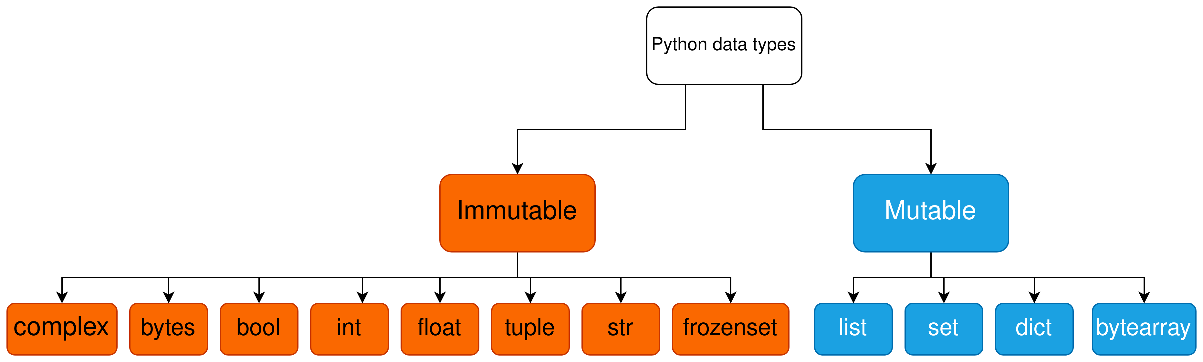
Mutability
Mutability basically means the tendency of something to change.
In Python, this means the tendency of an “object” to change.

Slide 71
Mutability (cont.)
>>> a = 5 # Immutable
>>> b = a
>>> id(a) # id returns an integer that is the identity of the object.
140235258083760
>>> id(5)
140235258083760
>>> id(a) == id(5)
True
>>> id(a) == id(b)
True
>>> a = a + 1 # Immutable
>>> id(a) # The object's identity has totally changed.
140235258083792
>>> id(a) == id(b)
False

Slide 72
Mutability (cont.)
>>> a = [1, 2, 3, 4] # Mutable
>>> b = a
>>> id(a)
140235255723136
>>> a.append(5) # Adds the item 5 to the list.
>>> a
[1, 2, 3, 4, 5]
>>> id(a) # a's identity has not changed.
140235255723136
>>> b # Since b refers to the same object, b has also changed.
[1, 2, 3, 4, 5]

Slide 73
Mutability (cont.)
>>> text = "Mohammed" # Immutable
>>> id(text)
140235255724592
>>> text += " likes Winter."
>>> text
'Mohammed likes Winter.'
>>> id(text)
140235255720816

Slide 74
Mutability (cont.)
>>> text = "Oman" # Immutable
>>> id(text)
140235255724656
>>> text[0] = "A"
Traceback (most recent call last):
File "<stdin>", line 1, in <module>
TypeError: 'str' object does not support item assignment
>>> text = "A" + text[1:]
>>> text
'Aman'
>>> id(text)
140235255735728

Slide 75
Mutability (cont.)
>>> l = [1, 2, 3, 4] # Mutable
>>> t = (1, 2, 3, 4) # Immutable
>>> l[0] = 0
>>> l
[0, 2, 3, 4]
>>> t[0] = 0 # You can't modify elements in a tuple.
Traceback (most recent call last):
File "<stdin>", line 1, in <module>
TypeError: 'tuple' object does not support item assignment

Slide 76
Mutability (cont.)
>>> a = [1, 2, 3, 4] # Mutable
>>> b = a
>>> text1 = "Hello" # Immutable
>>> text2 = text1
>>> b.append(5) # Adds item 5 to the list
>>> text2 += " there"
>>> a
[1, 2, 3, 4, 5]
>>> text1
'Hello'

Slide 77
Mutability (cont.)
Mutable VS Immutable
Python Mutable data types are appropriate when you need to change them throughout your program.
Python Immutable data types are appropriate when your data does not change throughout your program.
>>> results = []
>>> results.append(5+2)
>>> results.append(8-3)
>>> results.append(5/2)
>>> results
[7, 5, 2.5]
>>> config = ("192.168.1.8", 8888)
>>>

Slide 78
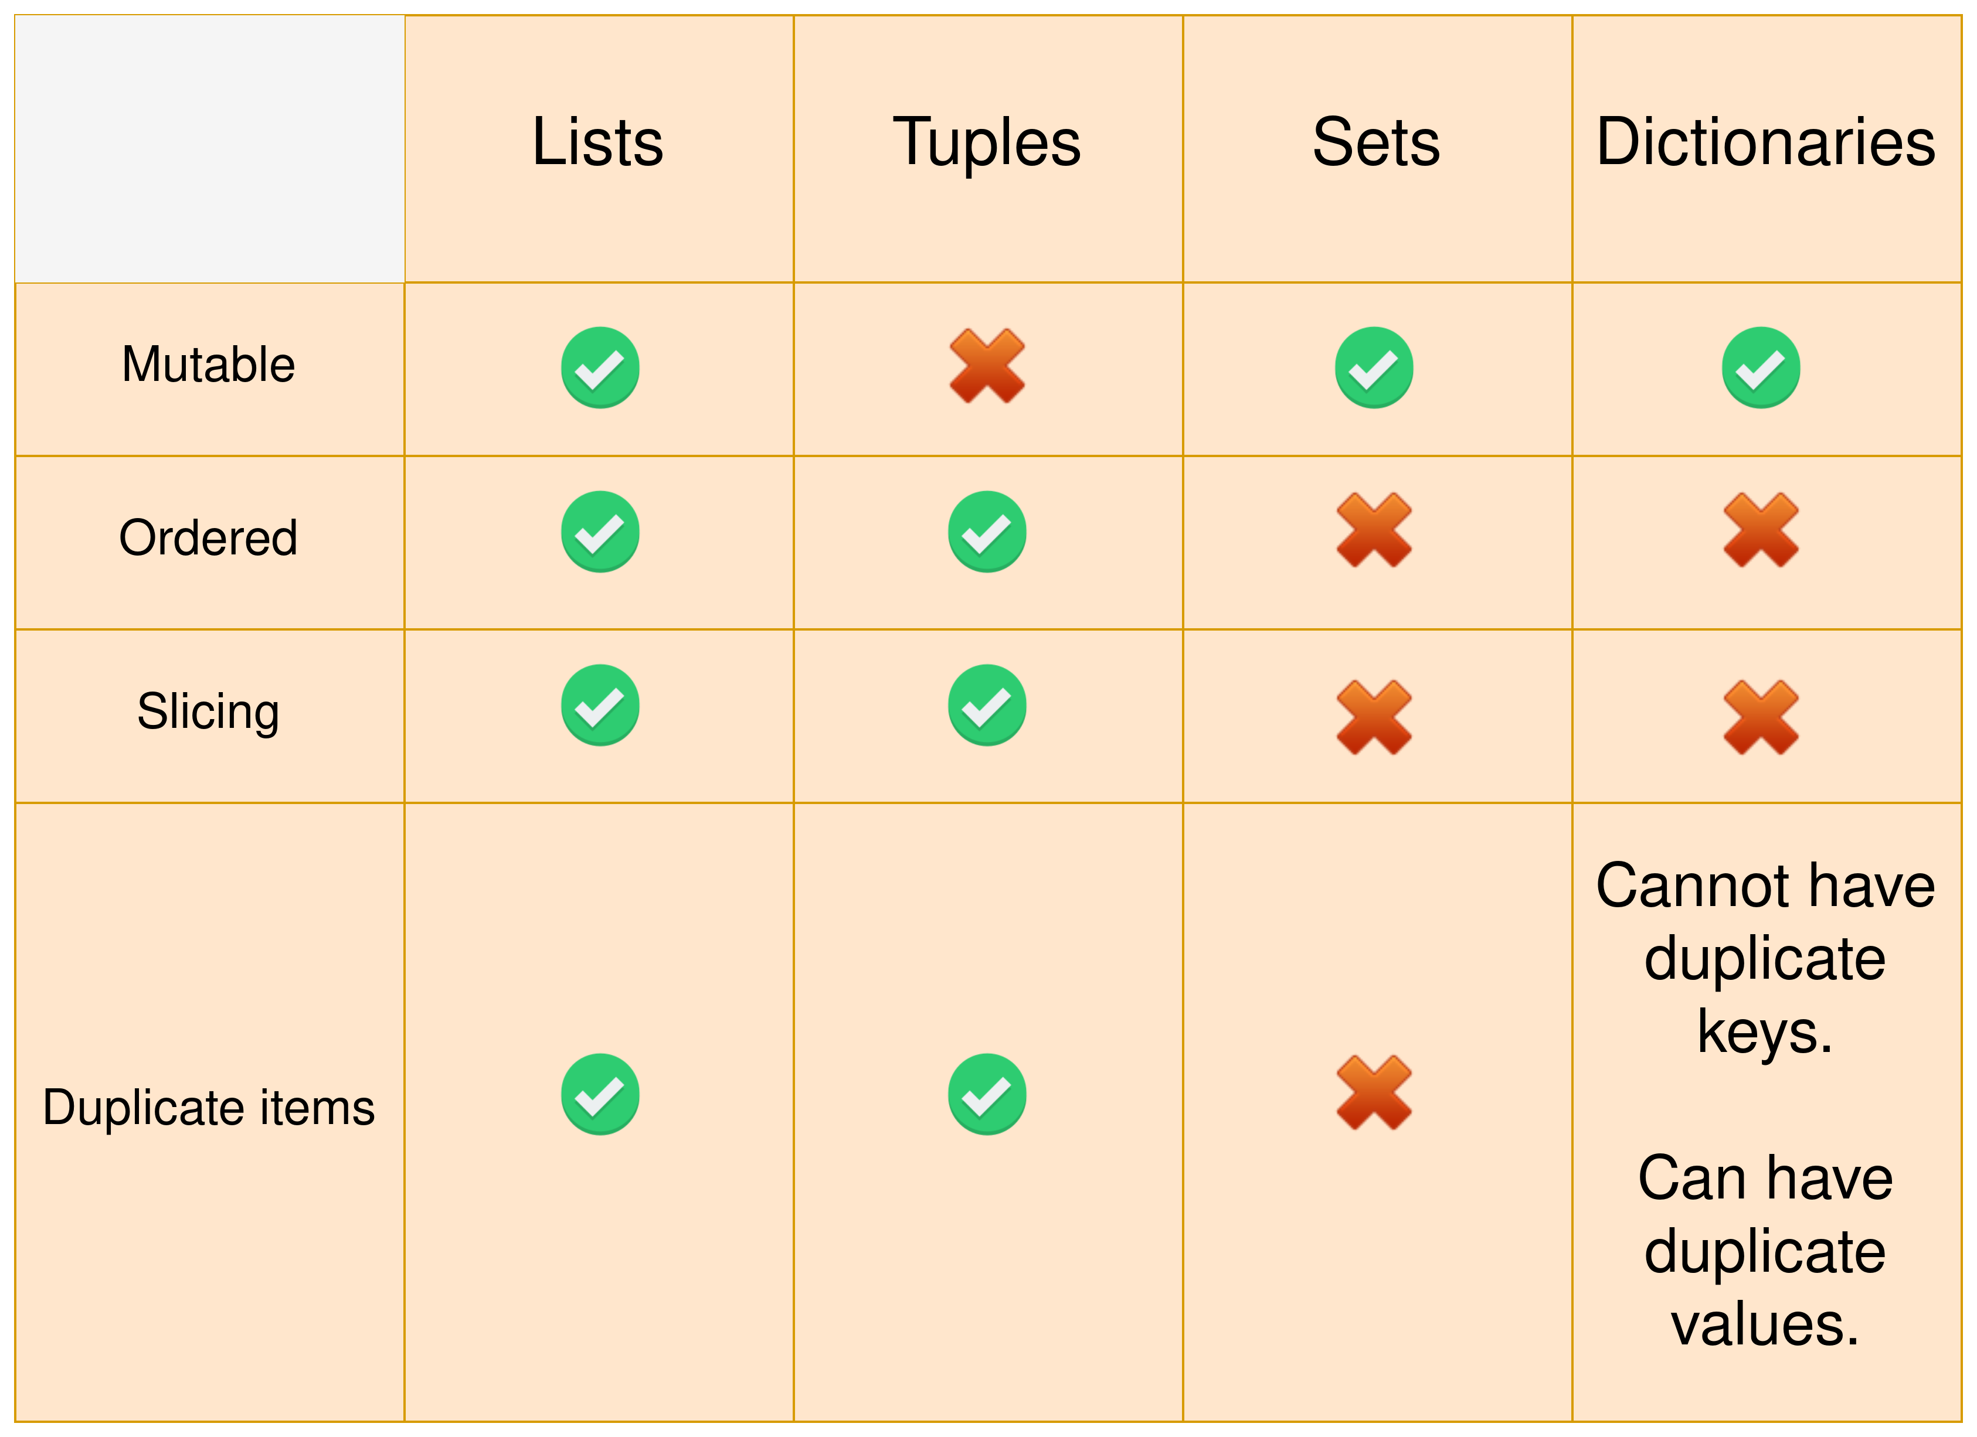
Lists, Tuples, Sets, Dictionaries

Slide 79
Lists, Tuples, Sets, Dictionaries
The following can help you decide when to use which data type
Use a list when
You have a specific order for your list items.
You want to modify those items at run time.
Use a tuple when
You have a specific order for your tuple items.
You don’t need to modify those items at run time.
Use a set when
You don’t necessarily care about the order in your set.
You need each item in your set to be unique (no duplicates).
You want to take advantage of the set features.
All your set items are immutable; sets cannot contain mutable items such as lists.
Use a dictionary when
You need a key/value association.

Slide 80
Flow control & Loop statements
if statement
>>> a = True
>>> if(a == True):
... print("a is true!")
...
a is true!
>>> if(a):
... print("a is not false!")
...
a is not false!
>>> a = [1, 2, 3, 4]
>>> if(a):
... print("a is not empty.")
...
a is not empty.
>>> b = []
>>> if(b):
... print("b is not empty")
...

Slide 81
Flow control & Loop statements (cont.)
if statement (cont.)
>>> a = 5
>>> if(a > 0):
... print("a is greater than 0")
...
a is greater than 0
>>> if(a > 0 and a < 10):
... print("a is greater than 0 and less than 10")
...
a is greater than 0 and less than 10

Slide 82
Flow control & Loop statements (cont.)
if statement (cont.)
Now we will switch to VSCode.
a = int(input("Enter a number: "))
if(a == 5):
print("You are correct!")
When a is not 5
Enter a number: 1
When a is 5
Enter a number: 5
You are correct!

Slide 83
Flow control & Loop statements (cont.)
Combining if with else statement
a = int(input("Enter a number: "))
if(a == 5):
print("You are correct!")
else:
print("You are not correct.")
When a is not 5
Enter a number: 3
You are not correct.
When a is 5
Enter a number: 5
You are correct!

Slide 84
Flow control & Loop statements (cont.)
Combining elif with both if and else statements
a = int(input("Enter a number: "))
if(a == 5):
print("You are correct!")
elif(a == 4):
print("You are getting close!")
elif(a == 6):
print("You are getting further away!")
else:
print("You are not correct.")
Enter a number: 4
You are getting close!
When a is 4
Enter a number: 6
You are getting further away!
When a is 6
Enter a number: 5
You are correct!
When a is 5

Slide 85
Flow control & Loop statements (cont.)
while statement
correct_answer = 5
a = 0 # temporary starting value
while a != correct_answer:
a = int(input("Enter a number: "))
if(a == correct_answer):
print("You are correct!")
elif(a == 4):
print("You are getting close!")
elif(a == 6):
print("You are getting further away!")
else:
print("You are not correct.")
As long as the answer is incorrect, while loop block will be executed.
The only way to exit the loop is through entering the correct answer(i.e., 5).
Enter a number: 2
You are not correct.
Enter a number: 4
You are getting close!
Enter a number: 6
You are getting further away!
Enter a number: 5
You are correct!
Output

Slide 86
Flow control & Loop statements (cont.)
for statement
l = [1, 2, 3, 4, 5]
for i in l:
print(i)
1
2
3
4
5
Output

Slide 87
Flow control & Loop statements (cont.)
for statement (cont.)
fruits = ["banana", "watermelon", "pineapple", "orange", "apple"]
for fruit in fruits:
if(fruit == "orange"):
print("We found " + fruit + "!")
Output
We found orange!

Slide 88
Flow control & Loop statements (cont.)
range function
>>> range(5)
range(0, 5)
>>> range(10)
range(0, 10)
>>> list(range(5))
[0, 1, 2, 3, 4]
>>> list(range(10))
[0, 1, 2, 3, 4, 5, 6, 7, 8, 9]
>>> list(range(5, 15))
[5, 6, 7, 8, 9, 10, 11, 12, 13, 14]
>>> list(range(2, 8, 2))
[2, 4, 6]
>>> list(range(8, 0, -1))
[8, 7, 6, 5, 4, 3, 2, 1]
>>> list(range(8, -1, -1))
[8, 7, 6, 5, 4, 3, 2, 1, 0]
>>> [i for i in range(5)]
[0, 1, 2, 3, 4]
>>> [i*10 for i in range(5)]
[0, 10, 20, 30, 40]

Slide 89
Flow control & Loop statements (cont.)
for statement (cont.)
fruits = ["banana", "watermelon", "pineapple", "orange", "apple"]
number_of_fruit_types = len(fruits) # length of fruits list
for i in range(number_of_fruit_types):
print("Looking at " + str(i))
if(fruits[i] == "orange"):
print("We found an orange at index " + str(i) + "!")
Looking at 0
Looking at 1
Looking at 2
Looking at 3
We found an orange at index 3!
Looking at 4
Output

Slide 90
Flow control & Loop statements (cont.)
for statement (cont.)
correct_answer = 5
for i in range(3): # Only tries 3 times!
a = int(input("Enter a number: "))
if(a == correct_answer):
print("You are correct!")
elif(a == 4):
print("You are getting close!")
elif(a == 6):
print("You are getting further away!")
else:
print("You are not correct.")
Enter a number: 2
You are not correct.
Enter a number: 8
You are not correct.
Enter a number: 6
You are getting further away!
Output

Slide 91

Flow control & Loop statements (cont.)
for statement (cont.)
correct_answer = 5
for i in range(3): # Only tries 3 times!
a = int(input("Enter a number: "))
if(a == correct_answer):
print("You are correct!")
elif(a == 4):
print("You are getting close!")
elif(a == 6):
print("You are getting further away!")
else:
print("You are not correct.")
There’s a problem though…
What if we already know the answer?
Enter a number: 5
You are correct!
Enter a number: 5
You are correct!
Enter a number: 5
You are correct!
Output

Slide 92
Flow control & Loop statements (cont.)
break statement on loops
correct_answer = 5
for i in range(3):
a = int(input("Enter a number: "))
if(a == correct_answer):
print("You are correct!")
break
elif(a == 4):
print("You are getting close!")
elif(a == 6):
print("You are getting further away!")
else:
print("You are not correct.")
Enter a number: 2
You are not correct.
Enter a number: 5
You are correct!
Output

Slide 93
Flow control & Loop statements (cont.)
continue statement on loops
correct_answer = 5
for i in range(3):
a = int(input("Enter a number: "))
if(a == correct_answer):
print("You are correct!")
break
elif(a == 4):
print("You are getting close!")
elif(a == 6):
print("You are getting further away!")
elif(a > 10):
continue # Go to next loop. Don't execute the code below.
else:
print("You are not correct.")
What if we want to ignore any value larger than 10? (i.e., not displaying any output if input is larger than 10)
Enter a number: 9
You are not correct.
Enter a number: 11
Enter a number: 20
Output

Slide 94
Flow control & Loop statements (cont.)
break vs continue statement on loops
break breaks the loop. No more loops get executed.
continue “continues” the loop at the next iteration without executing the code below it at that iteration.

Slide 95
Flow control & Loop statements (cont.)
else statement on loops
correct_answer = 5
for i in range(3):
a = int(input("Enter a number: "))
if(a == correct_answer):
print("You are correct!")
break
elif(a == 4):
print("You are getting close!")
elif(a == 6):
print("You are getting further away!")
elif(a > 10):
continue
else:
print("You are not correct.")
else:
# This will be executed only if the answer is not correct (no break).
print("You have failed the mission!")
else block gets executed when the loop does not hit any break.
Enter a number: 8
You are not correct.
Enter a number: 1
You are not correct.
Enter a number: 2
You are not correct.
You have failed the mission!
Output

Slide 96
Flow control & Loop statements (cont.)
match statement
f_name = "abc.log"
action = int(input("Enter your action to the file: "))
match action:
case 0:
print("Deleting the file..")
# .. delete_file(f_name)
case 1:
print("Creating the file..")
# .. create_file(f_name)
case 2:
print("Updating the file..")
# .. update_file(f_name)
case _:
print("Unknown command!")
Added as of Python 3.10
Output when action is 1
Enter your action to the file: 1
Creating the file..
Output when action is 2
Enter your action to the file: 2
Updating the file..
Output when action is 4
Enter your action to the file: 4
Unknown command!

Slide 97
Flow control & Loop statements (cont.)
match statement (cont.)
error_code = 3
match error_code:
case 0:
error_text = "Invalid input"
case 1:
error_text = "File is too large"
case 2:
error_text = "Cannot establish connection"
case _:
error_text = "Other error"
print(error_text)
Output
Other error
What if the error_code was a negative number?
We don’t want error_code to be valid when it’s negative.
In other words, we don’t want error_codes with negative numbers.
Meaning only positive (+0) error_codes are acceptable.

Slide 98
Flow control & Loop statements (cont.)
match statement (cont.)
error_code = -1
match error_code:
case 0:
error_text = "Invalid input"
case 1:
error_text = "File is too large"
case 2:
error_text = "Cannot establish connection"
case _ if error_code > 0:
error_text = "Other error"
case _:
error_text = None
print(error_text)
Output
None

Slide 99
Flow control & Loop statements (cont.)
assert statement
assert is used to make sure that a condition is met. If it’s not met, the program raises AssertionError.
assert is usually used as a debugging statement since it causes an error that halts the program in case the condition is not met.
assert takes a condition and an optional error message.
name = input("Enter your name: ")
assert len(name) != 0 # make sure name length is not 0
print(name[::-1])
Output when entering valid input
Enter your name: hello
olleh
Enter your name:
Traceback (most recent call last):
File "/tmp/test.py", line 3, in <module>
assert len(name) != 0
AssertionError
Output when hitting enter twice

Slide 100
Flow control & Loop statements (cont.)
assert statement (cont.)
You can add an optional message
name = input("Enter your name: ")
assert len(name) != 0, "name is empty"
print(name[::-1])
Enter your name:
Traceback (most recent call last):
File "/tmp/test.py", line 2, in <module>
assert len(name) != 0, "name is empty"
AssertionError: name is empty
Output when hitting enter twice

Slide 101
Flow control & Loop statements (cont.)
pass statement
pass means literally just to let the execution pass without doing anything.
# This will loop forever doing nothing (no action).
while True:
pass
A place holder for the function’s code (we will discuss functions next)
# Remember to implement this function!
def my_function():
pass
Creating a simple class with minimal code
class EmptyClass:
pass

Slide 102
Functions
Defining a function
def do_nothing():
pass
Defining a function & calling it
def say_hi():
print("Hi!")
say_hi()
Output of function say_hi
Hi!

Slide 103
Functions (cont.)
def say_hi_to(name):
print("Hi " + name + "!")
say_hi_to("Mohammed") say_hi_to("Khalid")
Hi Mohammed!
Hi Khalid!
Output

Slide 104
Functions (cont.)
def add(x, y):
return x+y
print(add(2, 4))
Output
6

Slide 105
Functions (cont.)
def average(l):
total = 0
for i in l:
total += i
return total/len(l)
print("The average is:", average([1,2,3,4,5]))
Output
The average is: 3.0

Slide 106
Functions (cont.)
Default arguments
def add(x, y=0):
return x+y
print(add(2))
print(add(2, 4))
Output
2
6

Slide 107
Functions (cont.)
Default arguments (cont.)
def say_hi(name="Default"):
print("Hi " + name + "!")
say_hi()
say_hi("Mohammed")
Output
Hi Default!
Hi Mohammed!

Slide 108
Functions (cont.)
Default arguments (cont.)
Normal arguments cannot come after default arguments
def add(x, y=10, z):
return x+y+z
Output
def add(x, y=10, z):
^
SyntaxError: non-default argument follows default argument

Slide 109
Functions (cont.)
Keyword arguments
def say_hi(name="Default"):
print("Hi " + name + "!")
say_hi() # Hi Default!
# passing a value through the name keyword
say_hi(name="Mohammed") # Hi Mohammed!
def add(x=0, y=0):
return x+y
print(add()) # 0
print(add(x=2)) # 2
print(add(x=2, y=4)) # 6

Slide 110
Functions (cont.)
Keyword arguments (cont.)
def do(op, *arguments):
if(op == '+'):
total = 0
for i in arguments:
total += i
elif(op == '*'):
total = 1
for i in arguments:
total *= i
return total
print(do('+', 5, 4, 3, 2))
print(do('*', 5, 5))
Output
14
25

Slide 111
Functions (cont.)
Keyword arguments (cont.)
def func(simple, *arguments, **keywords):
print("simple:", simple)
print("arguments:", arguments)
print("keywords:", keywords)
func(1, 2, 3, 4, 5, 6, seven=7, eight=8, nine=9)
simple: 1
arguments: (2, 3, 4, 5, 6)
keywords: {'seven': 7, 'eight': 8, 'nine': 9}
Output

Slide 112
Functions (cont.)
Standard, Positional-only, Positional-or-Keyword, and Keyword-Only arguments
By default, standard arguments can be passed either by position or by keyword
def func(name):
print(name)
func("Mohammed") # by position
func(name="Mohammed") # by keyword
Output
Mohammed
Mohammed

Slide 113
Functions (cont.)
Standard, Positional-only, Positional-or-Keyword, and Keyword-Only arguments (cont.)
What if you see this function?
def add_person(name, age=0, mobile=None):
print(name, age)
print(mobile)
This function can be called through several ways
add_person("Saif")
add_person(name="Saif")
add_person("Saif", age=29)
add_person("Saif", 29, 90909090)
add_person("Saif", 29, mobile=90909090)
add_person("Saif", age=29, mobile=90909090)
add_person(name="Saif", age=29, mobile=90909090)
This can cause some confusion, especially when there are several arguments and several people developing the code.
What if we want to restrict the way we provide arguments?

Slide 114
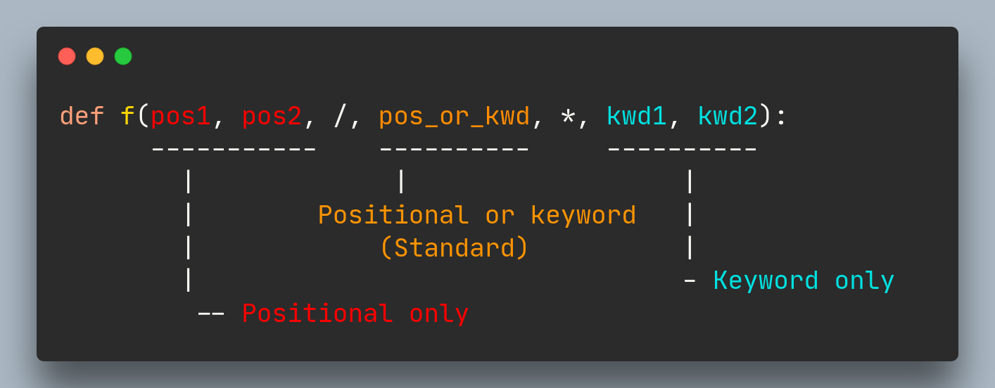
Functions (cont.)
Standard, Positional-only, Positional-or-Keyword, and Keyword-Only arguments (cont.)
Removing the confusion: (Python Enhancement Proposal) PEP 570 (Python 3.8)
Thanks to PEP 570, we can now specify which arguments are positional-only, and keyword-only.
RED: can only be passed by position.
Orange: can be passed by position/keyword.
Light blue: can be passed by keyword only.

Slide 115
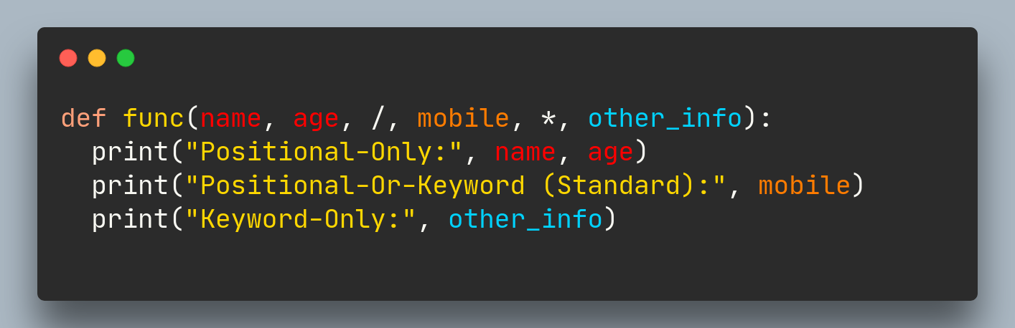
Functions (cont.)
Standard, Positional-only, Positional-or-Keyword, and Keyword-Only arguments (cont.)

Slide 116
Functions (cont.)
Standard, Positional-only, Positional-or-Keyword, and Keyword-Only arguments (cont.)
def func(name, age, /, mobile, *, other_info):
print("Positional-Only:", name, age)
print("Positional-Or-Keyword (Standard):", mobile)
print("Keyword-Only:", other_info)
func("Saif", 29, 90909090, other_info={"address":"1234 Muscat"})
func("Saif", 29, mobile=90909090, other_info={"address":"1234 Muscat"})
# The following line will cause an error:
func(name="Saif", age=29, mobile=90909090, other_info={"address":"1234 Muscat"})
Positional-Only: Saif 29
Positional-Or-Keyword (Standard): 90909090
Keyword-Only: {'address': '1234 Muscat'}
Positional-Only: Saif 29
Positional-Or-Keyword (Standard): 90909090
Keyword-Only: {'address': '1234 Muscat'}
Traceback (most recent call last):
...
func(name="Saif", age=29, mobile=90909090, other_info={"address":"1234 Muscat"})
TypeError: func() got some positional-only arguments passed as keyword arguments: 'name, age'
Output

Slide 117
Functions (cont.)
Standard, Positional-only, Positional-or-Keyword, and Keyword-Only arguments (cont.)
You can exclusively use Positional-Only & Keyword-Only arguments
def func(name, age, /, *, mobile, other_info):
print("Positional-Only:", name, age)
print("Keyword-Only:", mobile, other_info)
func("Saif", 29, mobile=90909090, other_info={"address":"1234 Muscat"})
# The next line will cause an error:
func("Saif", 29, 90909090, other_info={"address":"1234 Muscat"})
Positional-Only: Saif 29
Keyword-Only: 90909090 {'address': '1234 Muscat'}
Traceback (most recent call last):
...
func("Saif", 29, 90909090, other_info={"address":"1234 Muscat"})
TypeError: func() takes 2 positional arguments but 3 positional arguments (and 1 keyword-only argument) were given
Output

Slide 118
Functions (cont.)
Standard, Positional-only, Positional-or-Keyword, and Keyword-Only arguments (cont.)
You can exclusively use Positional-Only arguments
def func(name, age, mobile, other_info, /):
print("Positional-Only:", name, age, mobile, other_info)
func("Saif", 29, 90909090, {"address":"1234 Muscat"})
# The next line will cause an error:
func("Saif", 29, mobile=90909090, other_info={"address":"1234 Muscat"})
Positional-Only: Saif 29 90909090 {'address': '1234 Muscat'}
Traceback (most recent call last):
...
func("Saif", 29, mobile=90909090, other_info={"address":"1234 Muscat"})
TypeError: func() got some positional-only arguments passed as keyword arguments: 'mobile, other_info'
Output

Slide 119
Functions (cont.)
Standard, Positional-only, Positional-or-Keyword, and Keyword-Only arguments (cont.)
You can exclusively use Keyword-Only arguments
def func(*, name, age, mobile, other_info):
print("Keyword-Only:", name, age, mobile, other_info)
func(name="Saif", age=29, mobile=90909090, other_info={"address":"1234 Muscat"})
# The next line will cause an error:
func("Saif", 29, 90909090, {"address":"1234 Muscat"})
Keyword-Only: Saif 29 90909090 {'address': '1234 Muscat’}
Traceback (most recent call last):
...
func("Saif", 29, 90909090, {"address":"1234 Muscat"})
TypeError: func() takes 0 positional arguments but 4 were given
Output

Slide 120
Functions (cont.)
Standard, Positional-only, Positional-or-Keyword, and Keyword-Only arguments (cont.)
Ok. Now when to use which?
Positional-Only
If your parameter names have no real meaning to the user.
If you want to enforce the order of the function’s arguments.
If you want the parameter names to not be available to the user.
Positional-Only arguments are recommended when writing an API. This helps preventing API issues if the parameter names are modified in future.
Keyword-Only
If you don’t want to enforce the order of the function’s arguments.
If your parameter names have understandable meaning to the user.
In case you want to prevent the user from supplying them in positional arguments.
Positional-Or-Keyword (standard)
If you’re not writing an API & if you don’t care so much 😜

Slide 121
Functions (cont.)
Unpacking arguments
def add(x, y, z):
return x + y + z
l = [1, 2, 3]
print(add(*l)) # Output: 6

Slide 122
Functions (cont.)
Anonymous functions
Anonymous functions are defined with lambda
We use them when we require a function for a short period of time.
anon_add_four = lambda x: x + 4
print(anon_add_four(6)) # 10
print(anon_add_four(8)) # 12
Example 1
square = lambda x: x*x
print(square(4)) # 16
print(square(7)) # 49
print(square(8)) # 64
Example 2
multiply = lambda x, y: x*y
print(multiply(2, 5)) # 10
Example 3

Slide 123
Functions (cont.)
Anonymous functions (cont.)
We can define it and call it in one line
print((lambda x, y: x*y)(2, 5))

Slide 124
Functions (cont.)
Anonymous functions (cont.)
How about making it a little bit more complicated?
l = [5, 99, 21, 3123, 88, 99, 10, 22, 88, 109]
print((lambda l, f: [i for i in range(len(l)) if(l[i]==f)])(l, 88)) # Output: [4, 8]
A clearer version of it
l = [5, 99, 21, 3123, 88, 99, 10, 22, 88, 109]
length_of_l = len(l)
find_item_index = lambda l, f: [i for i in range(length_of_l) if(l[i]==f)]
result = find_item_index(l, 88)
print(result) # Output: [4, 8]
We’ll see later how/when anonymous functions get more useful.

Slide 125
Functions (cont.)
Function documentation (docstrings)
You can document your function. It’s optional but recommended.
Documenting your function adds the documentation to the __doc__ property.
Starts and ends with either """ or ''' .
def add(x, y):
"""
Adds x and y and returns the value.
Parameters:
x (int): a decimal integer
y (int): a decimal integer
Returns:
(x + y) (int): an integer representing the sum of x and y
"""
return x + y
print(add.__doc__) # Output: *the docstring written above*

Slide 126
Functions (cont.)
Function documentation (docstrings)
This documentation can be displayed conveniently with help built-in function
>>> help(add)
Help on function add in module __main__:
add(x, y)
Adds x and y and returns the value.
Parameters:
x (int): a decimal integer
y (int): a decimal integer
Returns:
(x + y) (int): an integer representing the sum of x and y

Slide 127
Functions (cont.)
Function Annotations
Function annotations are optional.
Annotations indicate the parameter type & return value.
Annotating your function adds the annotations to the __annotations__ property.
def add(x: int, y: int) -> int:
return x + y
def average(l: list) -> float:
return sum(l)/len(l)

Slide 128
Functions (cont.)
Built-in functions: hex function
Converts an integer to its hexadecimal representation value.
Note that it returns a str type value.
>>> hex(1)
'0x1'
>>> hex(11)
'0xb'
>>> hex(15)
'0xf'
>>> hex(16)
'0x10'
>>> hex(0o10)
'0x8'
>>> hex(0b101)
'0x5'
>>> hex(0x11)
'0x11'
>>> type(hex(0x11))
<class 'str'>

Slide 129
Functions (cont.)
Built-in functions: list function
Converts an iterable item such as tuple or set into a list
>>> t = (1, 2, 3, 4)
>>> type(t)
<class 'tuple'>
>>> l = list(t)
>>> l
[1, 2, 3, 4]
>>> type(l)
<class 'list'>
If no item is passed to list, then it creates an empty list
>>> l = list()
>>> l
[]

Slide 130
Functions (cont.)
Built-in functions: tuple function
Converts an iterable item such as list or set into a tuple
>>> l = [1, 2, 3, 4]
>>> t = tuple(l)
>>> t
(1, 2, 3, 4)
If no item is passed to tuple, then it creates an empty tuple
>>> empty_tuple = tuple()
>>> empty_tuple
()

Slide 131
Functions (cont.)
Built-in functions: set function
Converts an iterable item such as list or tuple into a set
>>> l = [1, 2, 3, 4]
>>> s = set(l)
>>> s
{1, 2, 3, 4}
If no item is passed to set, then it creates an empty set
>>> empty_set = set()
>>> empty_set
set()

Slide 132
Functions (cont.)
Built-in functions: map function
map is an important built-in function
It takes two arguments
A function.
Arguments for that function through an iterable object such as lists.
It returns an iterator (we will talk more about iterators later) of the results after it passes them to the target function.
def add_two(number):
return number + 2
l = [0, 8, 16, 24, 32]
result = map(add_two, l)
print(list(result)) # Output: [2, 10, 18, 26, 34]

Slide 133
Functions (cont.)
Built-in functions: map function (cont.)
def add_two_numbers(number1, number2):
return number1 + number2
l1 = [0, 8, 16, 24, 32]
l2 = [2, 4, 6, 8, 10]
result = map(add_two_numbers, l1, l2)
print(list(result)) # Output: [2, 12, 22, 32, 42]

Slide 134
Functions (cont.)
Built-in functions: map function (cont.)
Recreating the previous example with anonymous function
l1 = [0, 8, 16, 24, 32]
l2 = [2, 4, 6, 8, 10]
result = map(lambda n1,n2: n1 + n2, l1, l2)
print(list(result)) # Output: [2, 12, 22, 32, 42]

Slide 135
Functions (cont.)
Built-in functions: map function (cont.)
l1 = [0, 8, 16, 24, 32]
l2 = [2, 4, 6, 8, 10]
l3 = [5, 9, 2, 1, 4]
# adds (l1 + l2) * l3
result = map(lambda n1,n2,n3: (n1 + n2) * n3, l1, l2, l3)
result = list(result)
for i in range(len(result)):
print('(', l1[i], '+', l2[i], ')', '*', l3[i], '=', result[i])
( 0 + 2 ) * 5 = 10
( 8 + 4 ) * 9 = 108
( 16 + 6 ) * 2 = 44
( 24 + 8 ) * 1 = 32
( 32 + 10 ) * 4 = 168
Output

Slide 136
Functions (cont.)
Built-in functions: map function (cont.)
l1 = [0, 8, 16, 24, 32]
l2 = [2, 4, 6, 8, 10]
l3 = [5, 9, 2] # smaller than l1 & l2
# adds (l1 + l2) * l3
result = map(lambda n1,n2,n3: (n1 + n2) * n3, l1, l2, l3)
result = list(result)
for i in range(len(result)):
print('(', l1[i], '+', l2[i], ')', '*', l3[i], '=', result[i])
What if the lists aren’t of equal size?
map will continue until it reaches the end of one of the lists.
( 0 + 2 ) * 5 = 10
( 8 + 4 ) * 9 = 108
( 16 + 6 ) * 2 = 44
Output

Slide 137
Functions (cont.)
Built-in functions: map function (cont.)
names = ["Rashid", "Mohammed", "Tariq", "Khalid"]
result = map(len, names)
result = tuple(result)
print(result) # Output: (6, 8, 5, 6)

Slide 138
Functions (cont.)
Built-in functions: filter function (cont.)
filter behaves similarly to map, but it returns the results that match the condition of the target function.
Note that unlike map, filter can only take one iterable item.
def starts_with_T(name):
if(name[0] == 'T'):
return True
return False
names = ["Rashid", "Mohammed", "Tariq", "Khalid"]
result = filter(starts_with_T, names)
result = tuple(result)
print(result) # Output: ['Tariq']
Only names that start with the letter “T”.

Slide 139
Functions (cont.)
Built-in functions: filter function (cont.)
names = ["Rashid", "Mohammed", "Tariq", "Khalid"]
result = filter(lambda name: len(name) == 6, names)
result = tuple(result)
print(result) # ('Rashid', 'Khalid')
Only names that consist of 6 letters

Slide 140
Functions (cont.)
Built-in functions: filter function (cont.)
names = ["", "Rashid", "Mohammed", "", "Tariq", "Khalid", ""]
result = filter(None, names)
result = list(result)
print(result) # Output: ['Rashid', 'Mohammed', 'Tariq', 'Khalid']
Filter out empty strings

Slide 141
Functions (cont.)
Built-in functions: filter function (cont.)
l = [5, -8, -1, 22, 0, 58, -19, 13, 15]
result = filter(lambda x: x >= 0, l)
result = tuple(result)
print(result) # Output: (5, 22, 0, 58, 13, 15)
Only values that are equal or larger than 0

Slide 142
Functions (cont.)
Built-in functions: bytes and bytearray function (cont.)
bytes returns an object of type bytes.
bytearray returns an object of type bytearray.
>>> l = [1, 2, 3, 4]
>>> bytes(l)
b'\x01\x02\x03\x04'
>>> type(bytes(l))
<class 'bytes'>
>>> bytearray(l)
bytearray(b'\x01\x02\x03\x04')
>>> type(bytearray(l))
<class 'bytearray'>

Slide 143
Functions (cont.)
Built-in functions: bytes and bytearray function (cont.)
The most significant difference between them is bytes returns an immutable object, whereas bytearray returns a mutable object.
>>> l = [1, 2, 3, 4]
>>> my_bytes = bytes(l)
>>> my_bytes[0] = 5 # Error
Traceback (most recent call last):
File "<stdin>", line 1, in <module>
TypeError: 'bytes' object does not support item assignment
>>> my_bytearray = bytearray(l)
>>> my_bytearray[0] = 5
>>> my_bytearray
bytearray(b'\x05\x02\x03\x04')

Slide 144
Functions (cont.)
Built-in functions: bytes and bytearray function (cont.)
You can initialize bytes or bytearray objects to zero by passing the number of bytes you would like to have.
>>> bytes(5)
b'\x00\x00\x00\x00\x00'
>>> bytearray(5)
bytearray(b'\x00\x00\x00\x00\x00')
You can pass a string to convert into bytes-like object.
>>> bytes("hello", encoding="utf-8")
b'hello'
>>> bytearray("hello", encoding="utf-8")
bytearray(b'hello')

Slide 145
Functions (cont.)
Built-in functions: abs function (cont.)
Returns the absolute value of the passed argument
>>> abs(5)
5
>>> abs(-5)
5
>>> abs(0 - 8)
8
>>> abs(35 - 37)
2

Slide 146
More On Numbers
Comparing floats
>>> (0.1 + 0.2) == 0.3
False
>>> 0.1 + 0.1 + 0.1 - 0.3 == 0
False
Why?

Slide 147
More On Numbers
Comparing floats (cont.)
The reason is IEEE 754
Essentially, there are limitations in representing some floating-point numbers
>>> 0.2 + 0.1
0.30000000000000004
>>> 0.1 + 0.1 + 0.1 - 0.3
5.551115123125783e-17
For further read on why this happens, you can visit 0.30000000000000004.com
Let’s discuss how we can deal with it in Python.

Slide 148
More On Numbers
Comparing floats (cont.)
We can overcome this by implementing a function is_equal_float
def is_equal_float(a, b):
EPSILON = 1e-2
return abs(a - b) <= EPSILON
a = 0.2 + 0.1
b = 0.3
print(is_equal_float(a, b)) # True
print(is_equal_float(0.29, b)) # False
print(is_equal_float(0.309, b)) # True
print(is_equal_float(0.31, b)) # False

Slide 149
More On Numbers
Comparing floats (cont.)
We can also use the decimal module provided by Python
>>> from decimal import Decimal
>>> Decimal('0.2') + Decimal('0.1') == Decimal('0.3')
True
>>> Decimal('0.1') + Decimal('0.1') + Decimal('0.1') - Decimal('0.3') == 0
True
decimal module is recommended for accounting applications that deal a lot with numbers and have “strict equality invariants.”

Slide 150
More On Strings
Strings methods: count method
Counts the occurrences of the specified character
It can take optional start and end index.
>>> my_string = "Hello There!"
>>> my_string.count('e')
3
>>> my_string.count('e', 0, 5)
1

Slide 151
More On Strings
Strings methods: encode method
Converts the string into the specified encoding.
It returns an object of type “bytes”.
>>> my_string = "Hello There!"
>>> my_string.encode() # UTF-8
b'Hello There!'
>>> type(my_string.encode())
<class 'bytes'>
>>> my_string.encode(encoding="UTF-16LE")
b'H\x00e\x00l\x00l\x00o\x00 \x00T\x00h\x00e\x00r\x00e\x00!\x00'

Slide 152
More On Strings
Strings methods: startswith/endswith methods
>>> my_string
'Hello There!'
>>> my_string.startswith('B')
False
>>> my_string.startswith('H')
True
>>> my_string.startswith('Hello')
True
>>> my_string.endswith('!')
True
>>> my_string.endswith('e!')
True

Slide 153
More On Strings
Strings methods: startswith/endswith methods (cont.)
>>> my_string = "Hello There!"
>>> my_string.startswith('T', 6)
True
>>> my_string.startswith('Th', 6)
True
>>> my_string.endswith('lo', 0, 3)
False
>>> my_string.endswith('lo', 0, 5)
True

Slide 154
More On Strings
Strings methods: find/rfind methods
>>> my_string = "Hello There!"
>>> my_string.find('e')
1
>>> my_string[1]
'e'
>>> my_string[1:]
'ello There!'
>>> my_string.rfind('e')
10
>>> my_string[10:]
'e!'

Slide 155
More On Strings
Strings methods: find/rfind methods (cont.)
>>> my_string
'Hello There!'
>>> my_string.find('e', 6)
8
>>> my_string[8:]
'ere!'
>>> my_string.find('x') # If not found returns -1
-1

Slide 156
More On Strings
Strings methods: index/rindex methods
Behaves similarly to find / rfind but throws an exception if the substring is not found.
index is available to strings, tuples, and lists while find is only available to strings.
>>> my_string = "Hello There!"
>>> my_string.index('e')
1
>>> my_string.rindex('e')
10
>>> my_string.rindex('v')
Traceback (most recent call last):
File "<stdin>", line 1, in <module>
ValueError: substring not found
You can use specify the start and end for the second and third argument.

Slide 157
More On Strings
Strings methods: lower/upper/swapcase methods
>>> my_string
'Hello There!'
>>> my_string.upper()
'HELLO THERE!'
>>> my_string.lower()
'hello there!'
>>> my_string.swapcase()
'hELLO tHERE!'

Slide 158
More On Strings
Strings methods: strip/rstrip/lstrip methods
Removes white spaces by default
>>> my_string = " Hello There! "
>>> my_string.strip()
'Hello There!'
>>> my_string.rstrip()
' Hello There!'
>>> my_string.lstrip()
'Hello There! '

Slide 159
More On Strings
Strings methods: strip/rstrip/lstrip methods (cont.)
>>> my_string = ".........Hello There!**********"
>>> my_string.strip()
'.........Hello There!**********'
>>> my_string.strip('*')
'.........Hello There!'
>>> my_string.strip('.')
'Hello There!**********'
>>> my_string.strip('.').strip("*")
'Hello There!'
>>> my_string.lstrip('.').rstrip("*")
'Hello There!'

Slide 160
More On Strings
Strings methods: split method
>>> my_string = "Hello There!"
>>> my_string.split(" ")
['Hello', 'There!']
>>> my_string = "Hello There! Python is so powerful!"
>>> my_string.split(" ")
['Hello', 'There!', 'Python', 'is', 'so', 'powerful!']
>>> my_string.split(" ")[0]
'Hello'
>>> my_string.split(" ")[3]
'is'

Slide 161
More On Strings
Strings methods: split method (cont.)
>>> my_string = "Hello There! Python is so powerful! "
>>> my_string.split(" ")
['Hello', 'There!', 'Python', 'is', 'so', 'powerful!', '', '', '']
>>> list(filter(None, my_string.split(" ")))
['Hello', 'There!', 'Python', 'is', 'so', 'powerful!']

Slide 162
More On Strings
Strings methods: replace method
>>> my_string = "Hello There!"
>>> my_string.replace("e", "3")
'H3llo Th3r3!'
>>> my_string.replace("e", "3").replace("l", "1")
'H311o Th3r3!'
>>> my_string.replace("There", "World")
'Hello World!'

Slide 163
More On Strings
Strings methods: maketrans / translate methods
You can “translate” or “map” letters/characters so that they get replaced by others
>>> my_string = "Hello There!"
>>> my_string.replace("e", "3").replace("o", "0").replace("T", "7")
'H3ll0 7h3r3!'
>>> my_string.maketrans("eloT", "3107")
{101: 51, 108: 49, 111: 48, 84: 55}
>>> my_string.translate({101: 51, 108: 49, 111: 48, 84: 55})
'H3110 7h3r3!'

Slide 164
More On Strings
Strings methods: join method
Joins an iterable of strings
>>> words = ["Khalid", "likes", "Python"]
>>> ''.join(words)
'KhalidlikesPython'
>>> ' '.join(words)
'Khalid likes Python'
>>> ','.join(words)
'Khalid,likes,Python'

Slide 165
More On Strings
Strings methods: format method
>>> my_string = "Hello {}! You probably like {} and {}"
>>> my_string.format("Khalid", "Python", "Formatting")
'Hello Khalid! You probably like Python and Formatting'

Slide 166
More On Strings
Strings methods: format method (cont.)
>>> my_string = "Hello {0}! You probably like {1} and {2}"
>>> my_string.format("Khalid", "Python", "Formatting")
'Hello Khalid! You probably like Python and Formatting'
>>> my_string = "Hello {0}! You probably like {2} and {1}"
>>> my_string.format("Khalid", "Python", "Formatting")
'Hello Khalid! You probably like Formatting and Python'

Slide 167
More On Strings
Strings methods: format method (cont.)
>>> my_string = "Hello {name}! You probably like {item1} and {item2}"
>>> my_string.format(name="Khalid", item1="Python", item2="Formatting")
'Hello Khalid! You probably like Python and Formatting'
>>> my_string = "Hello {name}! You probably like {0} and {1}"
>>> my_string.format("Python", "Formatting", name="Khalid")
'Hello Khalid! You probably like Python and Formatting'

Slide 168
More On Strings
f-strings
>>> name = "Khalid"
>>> print(f"Hello {name}")
Hello Khalid
>>> name, items = "Khalid", ("Python", "Formatting")
>>> my_string = f"Hello {name}! You probably like {items[0]} and {items[1]}"
>>> print(my_string)
Hello Khalid! You probably like Python and Formatting

Slide 169
More On Strings
f-strings (cont.)
def print_info(info):
print("{0:8} - {1:8}".format("Name", "Phone"))
for name, phone in info.items():
print(f"{name:8} - {phone:8d}") # d for decimal.
info = {"Khalid": 90909090, "Mohammed": 91919191, "Tariq": 92929292}
print_info(info)
Name - Phone
Khalid - 90909090
Mohammed - 91919191
Tariq - 92929292
Output

Slide 170
More On Strings
f-strings (cont.)
>>> name = "khalid"
>>> my_string = f"{name.upper()} likes the number {55*2}"
>>> print(my_string)
KHALID likes the number 110
You can find more on f-strings here

Slide 171
More On Strings
The Old Way of formatting strings
You can use the % operator to indicate the location where the string/value should be placed.
This is called string interpolation.
>>> my_string = "%s likes the number %d" % ("Khalid", 55*2)
>>> print(my_string)
Khalid likes the number 110

Slide 172
More On Strings
The Old Way of formatting strings
You can use the % operator to indicate the location where the string/value should be placed.
This is called string interpolation.
>>> my_string = "%s likes the number %d" % ("Khalid", 55*2)
>>> print(my_string)
Khalid likes the number 110

Slide 173
More On Strings
Other string functions
For an extended list of string methods, you can visit Python page documentation.
You can also get help interactively through Python’s interactive shell
>>> my_string.
my_string.capitalize() my_string.ljust(
my_string.casefold() my_string.lower()
...
my_string.find( my_string.replace(
my_string.format( my_string.rfind(
...
>>> help(my_string.replace)
replace(old, new, count=-1, /) method of builtins.str instance
Return a copy with all occurrences of substring old replaced by new.
count
Maximum number of occurrences to replace.
-1 (the default value) means replace all occurrences.
If the optional argument count is given, only the first count occurrences are
replaced.

Slide 174
More On Lists
List methods: append method
Appends/adds the item to the end of the list.
>>> l = [1, 2, 3, 4, 5]
>>> l.append(6)
>>> l
[1, 2, 3, 4, 5, 6]
>>> l.append("Hello there")
>>> l
[1, 2, 3, 4, 5, 6, 'Hello there']

Slide 175
More On Lists
List methods: insert method
Insert the item at index.
>>> l = ['a', 'c', 'e']
>>> l.insert(1, 'b')
>>> l
['a', 'b', 'c', 'e']
>>> l.insert(3, 'd')
>>> l
['a', 'b', 'c', 'd', 'e']

Slide 176
More On Lists
List methods: extend method
Appends the items of an iterable to the end of the list.
>>> l = [1, 2, 3, 4, 5]
>>> l.extend((6, 7, 8, 9))
>>> l
[1, 2, 3, 4, 5, 6, 7, 8, 9]
>>> l.extend({10, 11, 12, 13})
>>> l
[1, 2, 3, 4, 5, 6, 7, 8, 9, 10, 11, 12, 13]
>>> l.extend([14, 15])
>>> l
[1, 2, 3, 4, 5, 6, 7, 8, 9, 10, 11, 12, 13, 14, 15]

Slide 177
More On Lists
List methods: count method
Counts the occurrences of an item in a list.
>>> l = ['a', 'p', 'p', 'l', 'e']
>>> l.count('a')
1
>>> l.count('p’)
2
>>> l = [8, 5, 9, 5, 5, 8]
>>> l.count(8)
2
>>> l.count(5)
3
>>> l.count(9)
1

Slide 178
More On Lists
List methods: index method
Returns the index where the item can be found
>>> word = ['a', 'p', 'p', 'l', 'e']
>>> word.index('e')
4
>>> word[4]
'e'
>>> word.index('p', 1, 3)
1
>>> word.index('p', 2, 3)
2
>>> word.index('p', 4)
Traceback (most recent call last):
File "<stdin>", line 1, in <module>
ValueError: 'p' is not in list

Slide 179
More On Lists
List methods: pop/remove methods
remove removes the first occurrence of the value
pop “pops” the item at the index and returns it
>>> word = ['a', 'p', 'p', 'l', 'e']
>>> word.remove('p')
>>> word
['a', 'p', 'l', 'e']
>>> word.pop(1)
'p'
>>> word
['a', 'l', 'e']

Slide 180
More On Lists
List methods: sort method
Sorts the list
>>> word = ['a', 'p', 'p', 'l', 'e']
>>> word.sort()
>>> word
['a', 'e', 'l', 'p', 'p']
>>> word.sort(reverse=True)
>>> word
['p', 'p', 'l', 'e', 'a']

Slide 181
More On Lists
List methods: reverse method
Reverses the order of the list
>>> word = ['a', 'p', 'p', 'l', 'e']
>>> word.reverse()
>>> word
['e', 'l', 'p', 'p', 'a']
>>> word.reverse()
>>> word
['a', 'p', 'p', 'l', 'e']

Slide 182
More On Lists
List methods: copy method
Creates a copy of the list.
But why don’t we use the assignment operator = instead of copy? Let’s talk about it..
>>> word1 = ['a', 'p', 'p', 'l', 'e']
>>> word2 = word1
>>> word2
['a', 'p', 'p', 'l', 'e']
>>> word2.append('a')
>>> word2
['a', 'p', 'p', 'l', 'e', 'a']
>>> word1
['a', 'p', 'p', 'l', 'e', 'a']
Although we have appended an ‘a’ to word2, word1 has also been affected.
This is why you need to create a copy of the list in case you want two separate word lists.

Slide 183
More On Lists
List methods: copy method (cont.)
Creates a copy of the list.
>>> word1 = ['a', 'p', 'p', 'l', 'e']
>>> word2 = word1.copy()
>>> word2.append('a')
>>> word2
['a', 'p', 'p', 'l', 'e', 'a']
>>> word1
['a', 'p', 'p', 'l', 'e']

Slide 184
More On Lists
List methods: copy method (cont.)
Creates a copy of the list.
>>> word1 = ['a', 'p', 'p', 'l', 'e']
>>> word2 = word1[:] # alternative to word1.copy()
>>> word2.append('a')
>>> word2
['a', 'p', 'p', 'l', 'e', 'a']
>>> word1
['a', 'p', 'p', 'l', 'e']

Slide 185
More On Lists
List methods: clear method
Clears the list
>>> word = ['a', 'p', 'p', 'l', 'e']
>>> word
['a', 'p', 'p', 'l', 'e']
>>> word.clear()
>>> word
[]

Slide 186
More On Lists
del statement
deletes the binding/connection between the variable and its object.
You can use it to delete any object.
The difference between del and pop on elements is that del does not return the element after it has been deleted.
>>> word = ['a', 'p', 'p', 'l', 'e']
>>> del word[1]
>>> word
['a', 'p', 'l', 'e']

Slide 187
More On Lists
del statement
deletes the binding/connection between the variable and its object.
>>> word1 = ['a', 'p', 'p', 'l', 'e']
>>> word2 = word1
>>> del word1
>>> word2
['a', 'p', 'p', 'l', 'e']
>>> word1
Traceback (most recent call last):
File "<stdin>", line 1, in <module>
NameError: name 'word1' is not defined

Slide 188
More On Lists
del statement
deletes the binding/connection between the variable and its object.
You can use del when you have used a built-in function name as a variable name, and then you want to use that built-in function in your code.
>>> result = ('a', 'letter')
>>> value, type = result
>>> print(value, type)
a letter
>>> print(type(value))
Traceback (most recent call last):
File "<stdin>", line 1, in <module>
TypeError: 'str' object is not callable
>>> del type
>>> print(type(value))
<class 'str'>

Slide 189
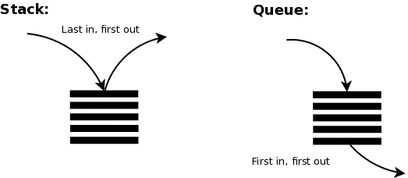
More On Lists
Stacks & Queues
Stack: LIFO (Last In, First Out).
Queue: FIFO (First In, First Out).

Slide 190
More On Lists
Stacks using Lists
Lists are can easily be used to work as a stack
>>> stack = []
>>> stack.append("book1")
>>> stack.append("book2")
>>> stack.append("book3")
>>> stack
['book1', 'book2', 'book3']
>>> stack.pop()
'book3'
>>> stack.pop()
'book2'
>>> stack.append("book4")
>>> stack
['book1', 'book4']

Slide 191
More On Lists
Queues using Lists
Traditional lists can also be used as queue, but they might not be efficient.
We can use collections.deque that has been designed for this purpose
>>> from collections import deque
>>> queue = deque([])
>>> queue.append("book1")
>>> queue.append("book2")
>>> queue.append("book3")
>>> queue
deque(['book1', 'book2', 'book3'])
>>> queue.popleft()
'book1'
>>> queue.popleft()
'book2'
>>> queue.append("book4")
>>> queue
deque(['book3', 'book4'])

Slide 192
More On Sets
Set methods: add/update methods
add adds an item to the set
update takes items of iterables and adds them to the set
>>> s = {0, 1, 2}
>>> s.add(3)
>>> s
{0, 1, 2, 3}
>>> s.update([4, 5])
>>> s.update((6, 7), {8, 9})
>>> s
{0, 1, 2, 3, 4, 5, 6, 7, 8, 9}

Slide 193
More On Sets
Set methods: discard/remove methods
discard removes an item, and if the item is not present, it won’t return anything.
remove removes an item, and if the item is not present, it will raise an error (KeyError).
>>> s = {1, 2, 3, 4, 5, 6}
>>> s.discard(1)
>>> s
{2, 3, 4, 5, 6}
>>> s.discard(8)
>>> s.remove(2)
>>> s.remove(8)
Traceback (most recent call last):
File "<stdin>", line 1, in <module>
KeyError: 8
>>> s
{3, 4, 5, 6}

Slide 194

More On Sets
Set methods: difference/difference_update methods
difference returns the difference between two or more sets.
difference_update removes all shared items with other sets.
>>> s1 = {0, 1, 3}
>>> s2 = {4, 2, 3}
>>> s1.difference(s2) # equivalent to s1 - s2
{0, 1}
>>> s1 - s2
{0, 1}
>>> s2.difference(s1) # equivalent to s2 - s1
{2, 4}
>>> s2 - s1
{2, 4}

Slide 195
More On Sets
Set methods: difference/difference_update methods (cont.)
difference returns the difference between two or more sets.
difference_update removes all shared items with other sets.
>>> s1 = {0, 1, 3}
>>> s2 = {4, 2, 3}
>>> s3 = {8, 1, 3}
>>> s1.difference(s2, s3)
{0}
>>> s2.difference(s1, s3)
{2, 4}
>>> s3.difference(s1, s2)
{8}

Slide 196
More On Sets
Set methods: difference/difference_update methods (cont.)
difference returns the difference between two or more sets.
difference_update removes all shared items with other sets.
>>> s1 = {0, 1, 3}
>>> s2 = {4, 2, 3}
>>> s3 = {8, 1, 3}
>>> s2.difference_update(s1, s3)
>>> s2
{2, 4}

Slide 197

More On Sets
Set methods: intersection/intersection_update methods
intersection returns the intersection of the sets.
intersection_update updates the set with value of the intersection between the current set and other sets..
>>> s1 = {0, 1, 3}
>>> s2 = {4, 2, 3}
>>> s3 = {8, 1, 3}
>>> s1.intersection(s2)
{3}
>>> s1 & s2
{3}
>>> s1.intersection(s3)
{1, 3}
>>> s1 & s3
{1, 3}

Slide 198
More On Sets
Set methods: intersection/intersection_update methods (cont.)
intersection returns the intersection of the sets.
intersection_update updates the set with value of the intersection between the current set and other sets..
>>> s1 = {0, 1, 3}
>>> s2 = {4, 2, 3}
>>> s3 = {8, 1, 3}
>>> s1 & s2 & s3
{3}
>>> s1.intersection_update(s2, s3)
>>> s1
{3}

Slide 199

More On Sets
Set methods: union method
union return the union of sets as a new set.
>>> s1 = {0, 1, 3}
>>> s2 = {4, 2, 3}
>>> s3 = {8, 1, 3}
>>> s1.union(s2) # equivalent to s1 | s2
{0, 1, 2, 3, 4}
>>> s1 | s2
{0, 1, 2, 3, 4}
>>> s1.union(s2, s3) # equivalent to s1 | s2 | s3
{0, 1, 2, 3, 4, 8}
>>> s1 | s2 | s3
{0, 1, 2, 3, 4, 8}

Slide 200

More On Sets
Set methods: symmetric_difference / symmetric_difference_update methods
symmetric_difference returns the symmetric difference between two sets.
symmetric_difference_update updates the set to the value of the symmetric difference of itself and another
>>> s1 = {0, 1, 3}
>>> s2 = {4, 2, 3}
>>> s3 = {8, 1, 3}
>>> s1.symmetric_difference(s2) # equivalent to s1 ^ s2
{0, 1, 2, 4}
>>> s1 ^ s2
{0, 1, 2, 4}
>>> s1.symmetric_difference(s3) # equivalent to s2
{8, 0}
>>> s1 ^ s3
{8, 0}

Slide 201
More On Sets
Set methods: symmetric_difference / symmetric_difference_update methods (cont.)
symmetric_difference returns the symmetric difference between two sets.
symmetric_difference_update updates the set to the value of the symmetric difference of itself and another
>>> s1 = {0, 1, 3}
>>> s2 = {4, 2, 3}
>>> s3 = {8, 1, 3}
>>> s1.symmetric_difference_update(s2)
>>> s1
{0, 1, 2, 4}
>>> s1.symmetric_difference_update(s3)
>>> s1
{0, 2, 3, 4, 8}

Slide 202
More On Sets
Set methods: pop method
pop removes and returns a random/arbitrary element from the set. If the set is empty, it will raise an exception (KeyError).
>>> s = {5, 8, 2}
>>> s.pop()
8
>>> s
{2, 5}
>>> s.pop()
2
>>> s.pop()
5
>>> s = set()
>>> s.pop()
Traceback (most recent call last):
File "<stdin>", line 1, in <module>
KeyError: 'pop from an empty set'

Slide 203
Writing Modules
A module is a collection of python code put together in a file (with .py extension).
# info.py
def get_info(d: dict):
for name, number in d.items():
print(name, number)
def get_names(d: dict):
for name in d.keys():
print(name)
def get_numbers(d: dict):
for number in d.values():
print(number)

Slide 204
Writing Modules
Your first module
Let’s create a file called “info.py” and put the following python code into it
# info.py
def get_info(d: dict):
for name, number in d.items():
print(name, number)
def get_names(d: dict):
for name in d.keys():
print(name)
def get_numbers(d: dict):
for number in d.values():
print(number)

Slide 205
Writing Modules
Importing your module
Now you can launch the Python interpreter and import it
Make sure that you have opened the Python interpreter in same working directory as your newly created info.py module
>>> import info
>>> table = {"Mohammed": 90909090, "Khalid": 91919191, "Salim": 92929292}
>>> info.get_info(table)
Mohammed 90909090
Khalid 91919191
Salim 92929292
>>> info.get_numbers(table)
90909090
91919191
92929292
>>> info.get_names(table)
Mohammed
Khalid
Salim

Slide 206
Writing Modules
When you import a module called “info”, Python search for it in this order
It checks the current working directory if there’s “info” module.
If not, then Python checks if there’s a built-in module called “info”.
You can import a specific function from a module:
>>> from info import get_names
>>> table = {"Mohammed": 90909090, "Khalid": 91919191, "Salim": 92929292}
>>> get_names(table)
Mohammed
Khalid
Salim

Slide 207
Writing Modules
You can import several functions from a module at once
>>> from info import get_names, get_numbers
>>> ...
You can import “everything” from a module
>>> from info import *
>>> ...
You can import the module with another name
>>> import info as ifo
>>> table = {"Mohammed": 90909090, "Khalid": 91919191, "Salim": 92929292}
>>> ifo.get_names(table)
Mohammed
Khalid
Salim

Slide 208
Writing Modules
You can import a function from the module with another name
>>> from info import get_names as gnames
>>> table = {"Mohammed": 90909090, "Khalid": 91919191, "Salim": 92929292}
>>> gnames(table)
Mohammed
Khalid
Salim
You can import several functions from the module with other names:
>>> from info import get_names as gnames, get_numbers as gnums
>>> gnames(table)
Mohammed
Khalid
Salim
>>> gnums(table)
90909090
91919191
92929292

Slide 209
Writing Modules
__name__ property
The __name__ property of a module is the module name.
>>> import info
>>> info.__name__
'info'
The value of the main module’s __name__ is __main__
>>> __name__
'__main__'
Where can this be useful?

Slide 210

Writing Modules
We will modify our module to include some more code
# info.py
def get_info(d: dict):
...
if __name__ == "info":
print("I have been imported!")
elif __name__ == "__main__":
print("I have been run directly")
d = {"Test": 12345678}
get_info(d)
Add this
Now if we try to import that module again:
>>> import info
I have been imported!

Slide 211
Writing Modules
If we try to run it directly
python info.py
I have been run directly
Test 12345678
Many Python scripts use this way to define the behavior taken if the script is run directly (i.e., not imported):
def main():
do_something()
...
if __name__ == "__main__":
main() # start the script only if it's run directly.

Slide 212
The dir Function
dir is a built-in function that returns the names and attributes available in an object.
Without an argument, dir will list all available names in current scope (we’ll talk about scopes later).
With an argument, dir will list all available names in the target scope.
>>> import info
I have been imported!
>>> dir()
['__annotations__', '__builtins__', '__doc__', '__loader__', '__name__', '__package__', '__spec__', 'info']
>>> dir(info)
['__builtins__', '__cached__', '__doc__', '__file__', '__loader__', '__name__', '__package__', '__spec__', 'get_info', 'get_names', 'get_numbers']

Slide 213
Standard Modules
sys
You can get arguments supplied in command line using sys module
import sys
length_of_args = len(sys.argv)
if(length_of_args >= 3):
arg0 = sys.argv[0] # name of file
arg1 = sys.argv[1]
arg2 = sys.argv[2]
print(f"Name of file: {arg0}")
print(f"Argument 1: {arg1}")
print(f"Argument 2: {arg2}")
print(f"Length of arguments: {length_of_args}")
else:
print("Please supply some more arguments.")
If we run the program through command line
python test.py first_argument second_argument
Name of file: test.py
Argument 1: first_argument
Argument 2: second_argument
Length of arguments: 3

Slide 214
Standard Modules
sys (cont.)
You can also change Python interpreter prompts
>>> sys.ps1
'>>> '
>>> sys.ps2
'... '
>>> sys.ps1 = "-> "
-> print("Hello!")
Hello!

Slide 215
Standard Modules
math
The math module can help you out when dealing with math problems
>>> import math
>>> math.cos(0)
1.0
>>> math.pi
3.141592653589793
>>> math.factorial(5) # 5!
120

Slide 216
Standard Modules
base64
base64 module contains functions that can help you encode/decode data to/from different encodings such as base16, base32, and base64 algorithms
>>> import base64
>>> base64.b64encode(b"Hello there!")
b'SGVsbG8gdGhlcmUh'
>>> output = base64.b64encode(b"Hello there!")
>>> base64.b64decode(output)
b'Hello there!'

Slide 217
Standard Modules
urllib
urllib module contains functions that can help you out when trying to make HTTP requests.
>>> import urllib.request
>>> res = urllib.request.urlopen("https://google.com")
>>> html = res.read()
>>> print(html[:15])
b'<!doctype html>'
>>> res.code
200
>>> res.msg
'OK'
>>> res.getheaders()
[('Set-Cookie', '1P_JAR=2021-11-28-17; ...)]

Slide 218
Standard Modules
json
json is a format used to interchange data usually between a server and a client.
json module contains functions that can help encode/decode Python data types to/from readable strings.
>>> import json
>>> d = {"Name": "Mohammed", "Age": 25}
>>> json.dumps(d)
'{"Name": "Mohammed", "Age": 25}'
>>> dump_str = json.dumps(d)
>>> json.loads(dump_str)
{'Name': 'Mohammed', 'Age': 25}
>>> load_d = json.loads(dump_str)
>>> type(load_d)
<class 'dict'>

Slide 219
Standard Modules
random
random module can be helpful when you need randomness in your python script (not for security purposes).
>>> import random
>>> l = [1, 2, 3, 4, 5, 6]
>>> random.choice(l)
2
>>> random.choice(l)
5
>>> random.choice(l)
6
>>> random.randint(0, 500)
397
>>> random.randint(0, 500)
211

Slide 220
Standard Modules
secrets
secrets module is used to generate cryptographically strong random numbers that can be used when dealing with passwords, tokens, and account authentication.
>>> import secrets
>>> l = [1, 2, 3, 4, 5, 6]
>>> secrets.choice(l)
4
>>> secrets.choice(l)
6
>>> secrets.token_urlsafe(32)
'F5SEGN_8eWqSUFh-nn0fnh18xgXlSt1ge-2GobzDZNk'

Slide 221
Standard Modules
re
re module provides regular expression matching operations.
>>> import re
>>> data = '<link rel="stylesheet" href="https://cdnjs.cloudflare.com/ajax/libs/font-awesome/5.15.0/css/all.min.css"><a href="https://twitter.com/D4rkness_14" target="_blank" class="fab fa-twitter fa-2x mx-1 my-2"></a>'
>>> re.findall("href=['\"]?([^'\" >]+)", data)
['https://cdnjs.cloudflare.com/ajax/libs/font-awesome/5.15.0/css/all.min.css', 'https://twitter.com/D4rkness_14']

Slide 222
Standard Modules
string
string module provide string constants and useful string operations
>>> import string
>>> string.ascii_letters
'abcdefghijklmnopqrstuvwxyzABCDEFGHIJKLMNOPQRSTUVWXYZ'
>>> string.ascii_lowercase
'abcdefghijklmnopqrstuvwxyz'
>>> string.digits
'0123456789'
>>> string.punctuation
'!"#$%&\'()*+,-./:;<=>?@[\\]^_`{|}~'
>>> t = string.Template("$name will buy this for $$100")
>>> t.substitute(name="Khalid")
'Khalid will buy this for $100'

Slide 223
Standard Modules
subprocess
subprocess allows to execute commands & launch new processes.
>>> import subprocess
>>> output = subprocess.check_output("calc")
On windows, this will pop up the calculator.

Slide 224
Creating Packages
Packages
Packages are a way of organizing modules.
Modules can be accessed using “dotted module names”.
bluetooth
__init__.py
constants.py
gui
__init__.py
animation.py
commonui.py
notification.py
plugins
__init__.py
plugin1.py
plugin2.py
services
dialupnetwork.py
functions.py
__init__.py
networkaccesspoint.py

Slide 225
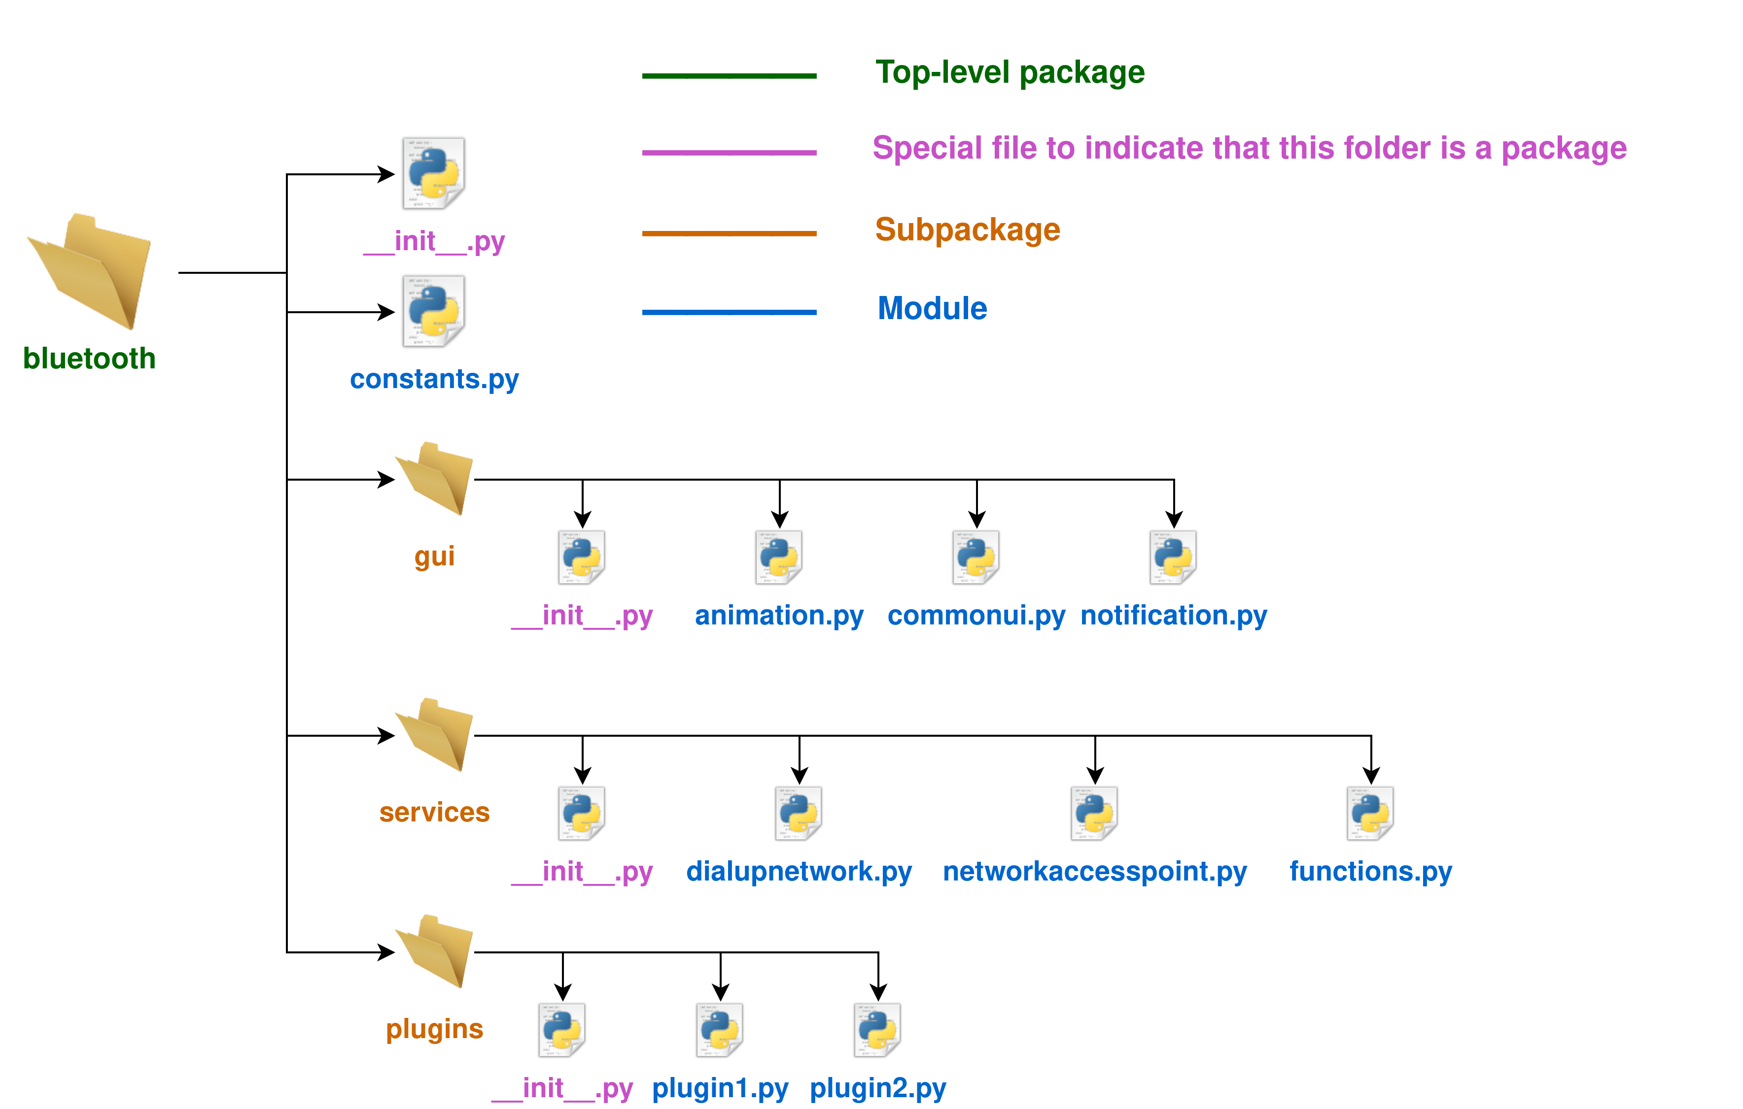
Creating Packages
Packages (cont.)
Download the fictious Bluetooth package.

Slide 226
Creating Packages
__init__.py file
This file is used to indicate that a folder is a package.
It can be as simple as an empty file.
It is used to initialize the code for the package or set the __all__ variable as we’ll see later.

Slide 227
Creating Packages
Using our package
We can use the package we’ve downloaded
>>> import bluetooth.constants
>>> bluetooth.constants.VERSION
'v0.1'
>>> import bluetooth.gui.animation
The animation module has been imported!
>>> bluetooth.gui.animation.animate1()
animate1 has been called.
>>> import bluetooth.gui.animation as animation
>>> animation.animate2()
animate2 has been called.

Slide 228
Creating Packages
Importing * from a package
When importing * from a module, the functions that start with _ are considered internal functions, so they’re not “exported” by default.
>>> from bluetooth.gui.animation import *
The animation module has been imported!
>>> animate3()
_internal_animate has been called.
>>> animate4()
_internal_animate has been called.
>>> _internal_animate()
Traceback (most recent call last):
File "<stdin>", line 1, in <module>
NameError: name '_internal_animate' is not defined

Slide 229
Creating Packages
Importing * from a package
What happens when we import * from bluetooth.gui subpackage?
>>> from bluetooth.gui import *
>>> animation.animate1()
Traceback (most recent call last):
File "<stdin>", line 1, in <module>
NameError: name 'animation' is not defined
>>> commonui.func1()
Traceback (most recent call last):
File "<stdin>", line 1, in <module>
NameError: name 'commonui' is not defined
We notice that submodules (animation, commonui, …etc) have not been imported.

Slide 230
Creating Packages
__all__ variable
__all__ list is used to define the submodules that will be loaded when trying to import all the packages as we did earlier
__all__ list is defined in __init__.py
We will update bluetooth/gui/__init__.py to include __all__ list
# bluetooth/gui/__init__.py
__all__ = ["animation", "commonui"]

Slide 231
Creating Packages
__all__ variable (cont.)
Now, when importing * from gui subpackage, only the animation and commonui modules will be loaded.
>>> from bluetooth.gui import *
The animation module has been imported!
The commonui module has been imported!
>>> animation.animate2()
animate2 has been called.
>>> commonui.func1()
commonui.func1 has been called!
>>> notification.push_notification()
Traceback (most recent call last):
File "<stdin>", line 1, in <module>
NameError: name 'notification' is not defined
When __all__ is not defined, the submodules are not imported when trying to use import * from a package.
from package import * is generally considered to be a bad practice in production environments.
It’s recommended to specify the module you want to use (i.e., from package import module_x.)

Slide 232
Creating Packages
Intra-package References
You can use a module/function from any subpackage.
Say you need to use the following in “bluetooth.gui.commonui” module:
The module bluetooth.gui.animation
The module bluetooth.plugins.plugin1
The function bluetooth.services.dialupnetwork.dialup
# bluetooth/gui/commonui.py
from . import animation # Importing a module
from ..plugins import plugin1 # Importing a module
from ..services.dialupnetwork import dialup # Importing a function
...

Slide 233
Playing With Files
You can use open built-in function to read/write files
open takes several arguments, and we’ll talk about two essential ones
First argument is the file path to open
Second argument is the mode which the file will be opened with (consists of mode, type, modifier)
There are several primary modes:
r open for reading (default)
w open for writing (after deleting/truncating its content if the file already exists)
x open for exclusive creation (will fail if the file already exists)
a appending to file (create a file if it doesn’t exist)
Types:
t open in text mode (default)
b open in binary mode.
Modifier
+ (reading and writing)
You can combine one of primary modes, types, the modifier to form a mode argument.
Mode r is assumed in case no mode is supplied.
Type t is assumed in case no type is supplied.

Slide 234
Playing With Files (cont.)
Writing to a file
>>> f = open("hello.txt", "w")
>>> f.write("Heloooooooo")
11
>>> f.read()
Traceback (most recent call last):
File "<stdin>", line 1, in <module>
io.UnsupportedOperation: not readable
>>> f.close()

Slide 235
Playing With Files (cont.)
Opening a file for reading
>>> f = open("hello.txt") # default "rt"
>>> f.read()
'Heloooooooo'
>>> f.write("Hi")
Traceback (most recent call last):
File "<stdin>", line 1, in <module>
io.UnsupportedOperation: not writable
>>> f.close()

Slide 236
Playing With Files (cont.)
Opening a file for reading & writing in text mode
Good practice to use with keyword (the file gets closed automatically).
>>> with open("hello.txt", "rt+") as f:
... original_output = f.read()
... f.write("This is another string..")
... f.seek(0) # go to the begining of the opened file.
... current_output = f.read()
...
24
0
>>> print(original_output)
Heloooooooo
>>> print(current_output)
HelooooooooThis is another string..

Slide 237
Playing With Files (cont.)
Opening a file that already exists with mode “x”
>>> f = open("hello.txt", "x")
Traceback (most recent call last):
File "<stdin>", line 1, in <module>
FileExistsError: [Errno 17] File exists: 'hello.txt'

Slide 238
Playing With Files (cont.)
Opening a file in binary mode
>>> with open("hello.txt", "rb") as f:
... print(f.read())
...
b'HelooooooooThis is another string..'

Slide 239
Playing With Files (cont.)
File Object methods: write method
writes to the file stream.
>>> f = open("test.txt", "w")
>>> f.write("This is the first line\nThis is the second line\nThis is the third line")
69
>>> f.close()

Slide 240
Playing With Files (cont.)
File Object methods: read method
reads the file stream (optionally providing the number of bytes/characters to read)
>>> f = open("test.txt", "r")
>>> f.read()
'This is the first line\nThis is the second line\nThis is the third line'
>>> f.close()

Slide 241
Playing With Files (cont.)
File Object methods: readline method
reads a line at a time.
>>> f = open("test.txt", "r")
>>> f.readline()
'This is the first line\n'
>>> f.readline()
'This is the second line\n'
>>> f.readline()
'This is the third line'
>>> f.readline()
''
>>> f.close()

Slide 242
Playing With Files (cont.)
File Object methods: seek method
goes to the nth byte in the file stream.
seek definition in Python:
seek(cookie, whence=0, /)
cookie is the offset to which you want to “seek”
whence
0 – start of stream (default)
1 – current stream position (offset can be negative). This is only supported when reading in binary mode.
2 – end of stream (offset usually negative). This is only supported when reading in binary mode.
>>> f = open("test.txt", "rb")
>>> f.seek(-4, 2) # go to the 4th byte before the end
65
>>> f.read()
b'line'
>> f.close()

Slide 243
Playing With Files (cont.)
File Object methods: tell method
“Tells” you at which offset you currently are.
>> f = open("test.txt", "rb")
>>> f.tell()
0
>>> f.seek(-4, 2) # go to the 4th byte before the end
65
>>> f.tell()
65
>>> f.read(1) # reads only one byte.
b'l'
>>> f.tell()
66
>>> f.close()

Slide 244
Exceptions
What are exceptions?
Errors that occur during execution are called exceptions.
When do Exceptions occur?
When some code results in an unexpected error, an exception is raised.
>>> result = 5 + count
Traceback (most recent call last):
File "<stdin>", line 1, in <module>
NameError: name 'count' is not defined
>>>
>>> s = "My favorite number is: " + 1234
Traceback (most recent call last):
File "<stdin>", line 1, in <module>
TypeError: can only concatenate str (not "int") to str
>>>
>>> 1/0
Traceback (most recent call last):
File "<stdin>", line 1, in <module>
ZeroDivisionError: division by zero

Slide 245
Exceptions (cont.)
What are exceptions?
Errors that occur during execution are called exceptions.
When do Exceptions occur?
When some code results in an unexpected error, an exception is raised.
>>> for i in range(-2, 3):
... print(8/i)
...
-4.0
-8.0
Traceback (most recent call last):
File "<stdin>", line 2, in <module>
ZeroDivisionError: division by zero

Slide 246
Exceptions (cont.)
Handling Exceptions
Exceptions can be handled through try and except statements
Handling the exception raised by division by zero.
>>> for i in range(-2, 3):
... try:
... print(8/i)
... except ZeroDivisionError:
... print("Cannot divide by zero!")
...
-4.0
-8.0
Cannot divide by zero!
8.0
4.0

Slide 247
Exceptions (cont.)
Handling Exceptions
Handling the exception raised by trying to read a non-existent file.
file_name = input("Enter your file name to read: ")
print("Trying to read the file:", file_name)
try:
with open(file_name, "r") as f:
print(f.read())
except FileNotFoundError:
print(f"File {file_name} was not found!")
> python test.py
Enter your file name to read: aaaaa.txt
Trying to read the file: aaaaa.txt
File aaaaa.txt was not found!
Output

Slide 248
Exceptions (cont.)
Handling Exceptions
Handling several exceptions:
file_name = input("Enter your file name to read: ")
print("Trying to read the file:", file_name)
try:
with open(file_name, "r") as f:
print(f.read())
except (FileNotFoundError, PermissionError) as e:
print(f"File {file_name} cannot be read due to: {e}")
except:
print("An error occured while reading the file.")
$ python test.py
Enter your file name to read: aaaa.txt
Trying to read the file: aaaa.txt
File aaaa.txt cannot be read due to: [Errno 2] No such file or directory: 'aaaa.txt'
Output

Slide 249
Exceptions (cont.)
Raising Exceptions
Exceptions can be raised for custom reasons using the raise keyword
file_name = input("Enter your file name to read: ")
print("Trying to read the file:", file_name)
try:
if(file_name == "secret.txt"):
raise PermissionError("You cannot read the secret file!")
with open(file_name, "r") as f:
print(f.read())
except (FileNotFoundError, PermissionError) as e:
print(f"File {file_name} cannot be read due to: {e}")
except:
print("An error occured while reading the file.")
> python test.py
Enter your file name to read: secret.txt
Trying to read the file: secret.txt
File secret.txt cannot be read due to: You cannot read the secret file!
Output

Slide 250
Exceptions (cont.)
User-defined Exceptions
You can define your own exception which you can later raise when an unintended event happens
This defines InvalidWithStandards exception which is raised when an incompatible device (coffee maker) is processed.
class InvalidWithStandards(Exception):
def __init__(self, ref, expected, received):
self.item_reference = ref
self.expected_value = expected
self.received_value = received
def __str__(self):
return "ref={}, expected_value={}, received_value={}".format(
self.item_reference,
self.expected_value,
self.received_value)
try:
item_ref = "COFFEE-MAKER-1234512345"
received_voltage = 120
expected_voltage = 240
if(received_voltage != expected_voltage):
raise InvalidWithStandards(item_ref, expected_voltage, received_voltage)
except InvalidWithStandards as e:
print("Received an item that's incompatiable with our company standards:")
print(e)
except:
print("Something else happend")

Slide 251
Exceptions (cont.)
class InvalidWithStandards(Exception):
def __init__(self, ref, expected, received):
self.item_reference = ref
self.expected_value = expected
self.received_value = received
def __str__(self):
return "ref={}, expected_value={}, received_value={}".format(
self.item_reference,
self.expected_value,
self.received_value)
try:
item_ref = "COFFEE-MAKER-1234512345"
received_voltage = 120
expected_voltage = 240
if(received_voltage != expected_voltage):
raise InvalidWithStandards(item_ref, expected_voltage, received_voltage)
except InvalidWithStandards as e:
print("Received an item that's incompatiable with our company standards:")
print(e)
except:
print("Something else happend")
User-defined Exceptions (cont.)
Output
Received an item that's incompatiable with our company standards:
ref=COFFEE-MAKER-1234512345, expected_value=240, received_value=120

Slide 252
Exceptions (cont.)
Clean-up after Exceptions
You can clean-up after the exception using finally keyword.
finally block will be executed regardless whether the exception is taken or not.
file_name = input("Enter your file name to read: ")
print("Trying to read the file:", file_name)
try:
with open(file_name, "r") as f:
print(f.read())
except (FileNotFoundError, PermissionError) as e:
print(f"File {file_name} cannot be read due to: {e}")
except:
print("An error occured while reading the file.")
finally:
print("Process completed.")

Slide 253
Exceptions (cont.)
Clean-up after Exceptions (cont.)
Output (entering a valid file test.txt)
Enter your file name to read: test.txt
Trying to read the file: test.txt
Hello there.
I like to program in Python.
Python is both powerful & easy.
Process completed.
Output (entering a non-existing file)
Enter your file name to read: aaaa.txt
Trying to read the file: aaaa.txt
File aaaa.txt cannot be read due to: [Errno 2] No such file or directory: 'aaaa.txt'
Process completed.

Slide 254
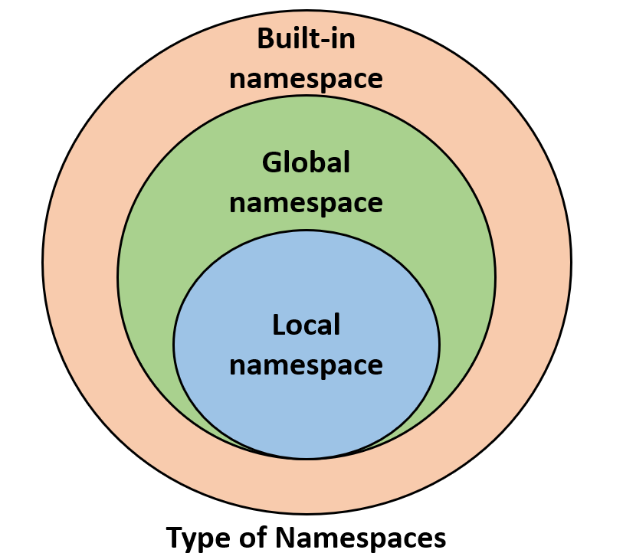
Namespaces & Scopes
Namespaces
A “namespace is a mapping from names to objects.”
Examples
Built-in namespace
Print and other built-in functions
Built-in exception names such as KeyboardInterrupt
Global namespace
Any global variables such as file_name
# test.py
file_name = "myfile.txt"
print(file_name)
Local namespace
Any local names to a function such as x and y
def test():
x = 8
y = "hi"
print(x, y)

Slide 255
Namespaces & Scopes (cont.)
Namespaces (cont.)
“Namespaces are created at different moments and have different lifetimes.”
Built-in namespace is created when Python starts and is never deleted
Global namespace is created when the module starts/imported and is normally deleted when Python quits
Local namespace is created when the function is called and is deleted when the function ends through either return or raising an unhandled exception.

Slide 256
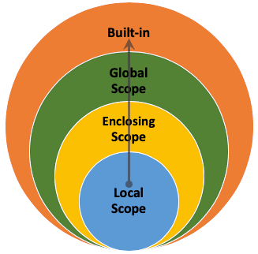
Namespaces & Scopes (cont.)
Scopes
A scope is “a textual region of a Python program where namespace is directly accessible.”
The scope concept defines the way that Python follows to access names such as: variables, functions, objects, … etc.
If Python doesn’t find a variable in the current scope, it will try to look for it in other scopes (above it)
name = "Rashid"
def test():
name = "Mohammed"
test()
print(name)
Output ?
Rashid

Slide 257
Namespaces & Scopes (cont.)
Scopes (cont.)
global keyword binds the name to the global scope
name = "Rashid"
def test():
global name
name = "Mohammed"
test()
print(name)
Output ?
Mohammed

Slide 258
Namespaces & Scopes (cont.)
Scopes (cont.)
def scope_test():
name = "Rashid"
def name_local():
name = "Khalid"
def name_nonlocal():
nonlocal name
name = "Mohammed"
def name_global():
global name
name = "Tariq"
name_local()
print("My name after name_local is", name)
name_nonlocal()
print("My name after name_nonlocal is", name)
name_global()
print("My name after name_global is", name)
scope_test()
print("My global name is", name)

Slide 259
Namespaces & Scopes (cont.)
Scopes (cont.)
def scope_test():
name = "Rashid"
def name_local():
name = "Khalid"
def name_nonlocal():
nonlocal name
name = "Mohammed"
def name_global():
global name
name = "Tariq"
name_local()
print("My name after name_local is", name) # My name after name_local is Rashid
name_nonlocal()
print("My name after name_nonlocal is", name) # My name after name_nonlocal is Mohammed
name_global()
print("My name after name_global is", name) # My name after name_global is Mohammed
scope_test()
print("My global name is", name) # My global name is Tariq
“To rebind variables found outside of the innermost scope, the nonlocal statement can be used”

Slide 260
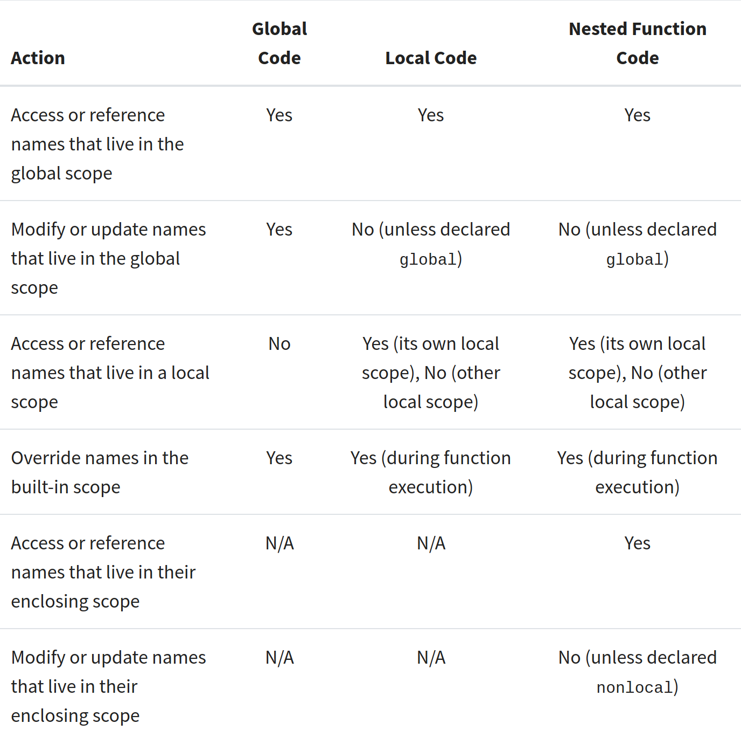
Namespaces & Scopes (cont.)
Scopes summary

Slide 261
Classes
Classes are an essential part paradigm OOP (Object-Oriented Programming).
Classes can be helpful in
Code organization
Tracking the state of an object
Inheritance
Code reusability
In Python, a class is essentially a namespace.
Class definition
A simple empty class can be written
class EmptyClass:
pass

Slide 262
Classes (cont.)
Class Objects
Creating objects from our empty class
class EmptyClass:
pass
first_object = EmptyClass()
second_object = EmptyClass()
first_object.value = 5
second_object.value = 22
print(first_object.value) # 5
print(second_object.value) # 22

Slide 263
Classes (cont.)
Object Methods
Object methods are functions within an instantiated class.
class TestClass:
def say_hello(self):
print("Hello!")
obj = TestClass()
obj.say_hello() # Hello!
TestClass.say_hello is called a class function
obj.say_hello is called an object method
Functions that belong to an object are called methods.
Class functions have an extra argument (conventionally named self).
self argument is used to pass the object itself.
...
obj = TestClass()
obj.say_hello() # Hello!
TestClass.say_hello(obj) # Hello!
# obj.say_hello() is equivalent to TestClass.say_hello(obj)

Slide 264
Classes (cont.)
Object Special Methods: __init__ method
__init__ method is used to initialize the object when it’s first instantiated
class Person:
def __init__(self, name):
self.name = name
def print_my_name(self):
print("My name is", self.name)
person1 = Person("Khalid")
person2 = Person("Mohammed")
person1.print_my_name() # My name is Khalid
person2.print_my_name() # My name is Mohammed
Here, __init__ is used to initialize the name that belongs to the object self with the argument it receives when Person is instantiated

Slide 265
Classes (cont.)
Object Special Methods: __str__ method
__str__ method is used to return a string that will represent the object
class Person:
def __init__(self, name):
self.name = name
def __str__(self):
return f"My name is {self.name}"
person1 = Person("Khalid")
print(person1) # My name is Khalid
person2 = Person("Mohammed")
print(person2) # My name is Mohammed

Slide 266
Classes (cont.)
Object Special Methods: __getitem__, __setitem__ methods
__ getitem__ is used when you try to index the object
__ setitem__ is used when you try to index the object to set it to a different value
class Person:
def __init__(self, name):
self.name = name
def __setitem__(self, n, val):
self.name = list(self.name)
self.name[n] = val
self.name = "".join(self.name)
def __getitem__(self, n):
return self.name[n]
def __str__(self):
return self.name
person = Person("Khalid")
print(person[2]) # __getitem__ will be called
person[2] = 's' # __setitem__ will be called
print(person)
Output
a
Khslid

Slide 267
Classes (cont.)
Object Special Methods
There are many more special methods, you can look them up here.

Slide 268
Classes (cont.)
Class variables & Instance variables
Sometimes you want to share a variable between all objects
class Person:
country = "Oman" # shared by all objects/persons
def __init__(self, name):
self.name = name # specific to each object
person1 = Person("Khalid")
print(person1.country) # Oman
person2 = Person("Mohammed")
print(person2.country) # Oman

Slide 269
Classes (cont.)
Inheritance
You can make your class inherit from another class
Inheritance from another class makes attributes found in base class/s available in your class.
class MalePerson:
gender = "Male"
class Person(MalePerson):
def __init__(self, name):
self.name = name
person = Person("Khalid")
print(person.gender) # Male

Slide 270
Classes (cont.)
Inheritance (cont.)
Sometimes you want to extend the functionality of a specific function in the base class
class MalePerson:
gender = "Male"
def get_name_len(self):
return len(self.name) # returns an int output
class Person(MalePerson):
def __init__(self, name):
self.name = name
def get_name_len(self):
output = super().get_name_len()
# returns a string result including int output
return f"The length of the name is {output}"
person = Person("Khalid")
print(person.get_name_len()) # The length of the name is 6

Slide 271
Classes (cont.)
Multiple Inheritance
Multiple inheritance can be thought of as inheriting attributes from parent/base classes (depth-first) from left to right.
class MyClass(A, B, C):
...
If an attribute is not found in MyClass, it’ll be searched in A and all its base classes. If it’s not found there, it’ll be searched in B and all its base classes, … and so on.

Slide 272
Classes (cont.)
Multiple Inheritance (cont.)
class A:
name = "AAAA"
def say_hi(self):
print("Hi!")
class B:
letter = 'B'
def say_hi(self):
print("Hi!!!!!!")
class C(A, B):
pass
c = C()
print(c.name, c.letter) # AAAA B
c.say_hi() # Hi!

Slide 273
Classes (cont.)
Multiple Inheritance (cont.)
class Person:
def __init__(self, name):
self.name = name
class MalePerson(Person):
gender = "Male"
class CollegeStudent(Person):
def __init__(self, name, college):
self.name = name
self.college = college
class MaleStudent(CollegeStudent, MalePerson):
pass
male_student = MaleStudent("Khalid", "SQU")
print(male_student.name, male_student.college, male_student.gender) # Khalid SQU Male

Slide 274
Decorators
You might notice the @ syntax in some Python code
class Person:
def __init__(self, name):
self.name = name
@property
def name_length(self):
return len(self.name)
person = Person("Mohammed")
print(person.name_length) # output: 8
property is a built-in function.
property in the above example is called a decorator (“@” syntax).
“A decorator in Python is a function that takes another function as its argument, and [usually] returns yet another function.”
However, In the above example, name_length is no longer a function, but a property.
A property can be set through a setter, get through a getter, and delete through a deleter.
property definition:
property(fget=None, fset=None, fdel=None, doc=None)

Slide 275
Decorators (cont.)
property definition:
property(fget=None, fset=None, fdel=None, doc=None)
The following code is equivalent to the previous example
class Person:
def __init__(self, name):
self.name = name
# @property
def name_length(self):
return len(self.name)
name_length = property(name_length) # equivalent to @property
person = Person("Mohammed")
print(person.name_length) # output: 8

Slide 276
Decorators (cont.)
The following two code snippets are equivalent
def call_three_times(func):
def inner():
func()
func()
func()
return inner
def say_hi():
print("Hi!")
say_hi = call_three_times(say_hi)
say_hi()
def call_three_times(func):
def inner():
func()
func()
func()
return inner
@call_three_times
def say_hi():
print("Hi!")
say_hi()
Without syntactic sugar
With syntactic sugar
Hi!
Hi!
Hi!
Output

Slide 277
Decorators (cont.)
time_this_func is a decorator that calculates the execution time of a target function.
from timeit import default_timer as timer
def time_this_func(func):
def inner():
start = timer()
func()
end = timer()
elapsed_time = end - start
print(func.__name__, "took", elapsed_time, "to execute.")
return inner
@time_this_func
def say_hi():
print("Hi!")
say_hi()
Output
Hi!
say_hi took 5.083996802568436e-05 to execute.

Slide 278
Iterators
Lists, tuples, strings, …etc are iterable using the “iterator protocol”.
>>> s = "Oman"
>>> for c in s:
... print(c)
...
O
m
a
n
How does this work?
for loops through the iterator and calls the special method __next__ over each iteration.

Slide 279
Iterators (cont.)
>>> s = "Oman"
>>> s_iter = iter(s)
>>> s_iter
<str_iterator object at 0x7fdfc699de20>
>>> next(s_iter)
'O'
>>> next(s_iter)
'm'
>>> next(s_iter)
'a'
>>> next(s_iter)
'n'
>>> next(s_iter)
Traceback (most recent call last):
File "<stdin>", line 1, in <module>
StopIteration
>>> s = "Oman"
>>> for c in s:
... print(c)
...
O
m
a
n

Slide 280
Iterators (cont.)
We can create a class that implements the “iterator protocol”
class Reverse:
def __init__(self, data):
self.data = data
self.index = len(data)
def __iter__(self):
return self
def __next__(self):
if(self.index == 0):
raise StopIteration
self.index = self.index - 1
return self.data[self.index]
reverse_word = Reverse("Oman")
for c in reverse_word:
print(c)
n
a
m
O
Output

Slide 281
Generators
Generators are a powerful way to create iterators.
A generator is essentially a function that has a yield keyword instead of return.
Previous Reverse example can be written as follows
def reverse(data):
for i in range(len(data)-1, -1, -1):
yield data[i]
for c in reverse("Oman"):
print(c)
In generators, __iter__ and __next__ are created automatically.

Slide 282
Generators (cont.)
yield isn’t really like a return
def my_range(upto_n):
index = 0
while index < upto_n:
yield index
index += 1
for i in my_range(5):
print(i, end=" ")
print() # 0 1 2 3 4

Slide 283
Generators (cont.)
yield from is used to yield values from a generator.
def my_range(upto_n):
index = 0
while index < upto_n:
yield index
index += 1
def wrapper():
yield from my_range(3)
yield from ['a', 'b', 'c']
yield from range(3, 6)
yield from ('d', 'e', 'f')
for i in wrapper():
print(i, end=" ") # 0 1 2 a b c 3 4 5 d e f
print()

Slide 284
Generators (cont.)
Generators/iterators can save up memory when processing a large set of values since they calculate values when they’re requested for.
>>> values = list(range(5, 8000000000))
Traceback (most recent call last):
File "<stdin>", line 1, in <module>
MemoryError
>>> values = iter(range(5, 8000000000))

Slide 285
Generator Expressions
Generators can be written in a linear form using parentheses ( and )
>>> my_genexpr = (i for i in range(500))
>>> my_genexpr
<generator object <genexpr> at 0x7fdfc68b97b0>
>>>
>>> word = "Oman"
>>> my_genexpr = (word[i] for i in range(len(word)-1, -1, -1))
>>> ''.join(my_genexpr)
'namO'
>>> list(zip(range(1, 4), range(4, 7)))
[(1, 4), (2, 5), (3, 6)]
>>> list_of_tuples = list(zip(range(1, 4), range(4, 7)))
>>> my_genexpr = (i*j for i, j in list_of_tuples)
>>> my_genexpr
<generator object <genexpr> at 0x7f087a808740>
>>> sum(my_genexpr)
32

Slide 286
Writing Tests
Writing tests is crucial during the development process to verify that the code runs as expected.
doctest module
The doctest module is simple & effortless.
Creating a test is as simple as copy-and-pasting the function call along with its results into the docstring (function documentation).
In case there’s a failure, a clear message will be provided to which test has failed along with expected/got values.
import doctest
def square_list(l: list) -> list:
"""Computes the square of each item in the list.
>>> square_list([4, 5, 6])
[16, 25, 36]
"""
for i in range(len(l)):
l[i] **= 2
return l
doctest.testmod()

Slide 287
Writing Tests (cont.)
unittest module
unittest is not as simple as doctest, but it has more advanced capabilities for testing code.
Many Python programmers use unittest to write their tests.
import unittest
from mycode import square_list
class MyCodeTest(unittest.TestCase):
def test_square_list(self):
self.assertEqual(square_list([4, 5, 6]), [16, 25, 36])
self.assertEqual(square_list([1.2, 3.8, 5.3]), [1.44, 14.44, 28.09])
self.assertEqual(square_list([0]), [0])
with self.assertRaises(TypeError):
square_list(4, 5)
unittest.main()
.
----------------------------------------------------------------------
Ran 1 test in 0.000s
OK
Output

Slide 288
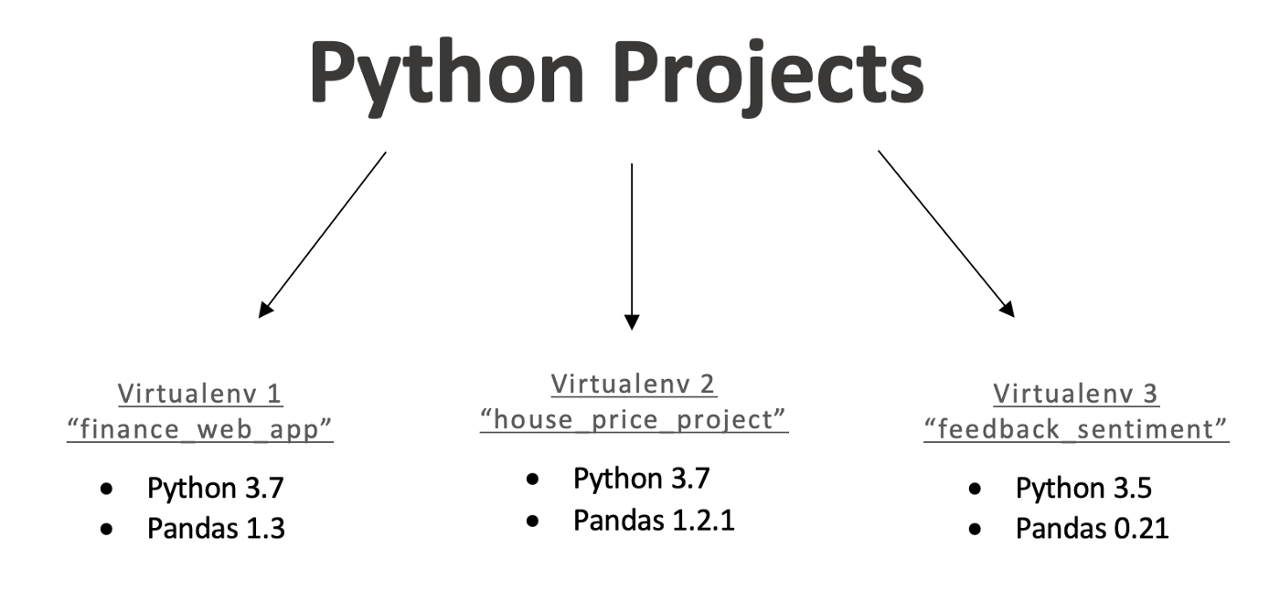
Virtual Environments
A virtual environment is “a self-contained directory tree that contains a Python installation for a particular version of Python, plus a number of additional packages”.
Virtual Environments are used to create isolated environments for Python projects.
Different projects can use different virtual enviornments that contain different versions of different packages/modules.

Slide 289
Virtual Environments (cont.)
Creating Virtual Environments
To create a virtual environment, we can use the venv module which is a part of the standard library.
python -m venv first-env
This will a directory “first-env”, which will contain necessary files and a copy of the Python interpreter.
To work within the virtual environment, you need to activate it.
On Windows, execute (make sure you’re not running within PowerShell):
PS C:\Users\user> cmd
Microsoft Windows [Version 10.0.19043.1165]
(c) Microsoft Corporation. All rights reserved.
C:\Users\user>.\first-env\Scripts\activate.bat
(first-env) C:\Users\user>
On Unix-like, execute:
bash-5.1$ source first-env/bin/activate
(first-env) bash-5.1$

Slide 290
Virtual Environments (cont.)
Managing Packages Within The Virtual Environment
pip is used to install, upgrade, and remove packages.
pip will install packages from pypi.org.
You can use it to install any package to the virtual environment.
Packages installed within the virtual environment will not be available system-wide.
Say you want to install a package called impacket in the Virtual Environment:
(first-env) C:\Users\user>pip install impacket
Collecting impacket
...
Running setup.py install for impacket ... done
Successfully installed ... impacket-0.9.24 ...
(first-env) C:\Users\user>python
>>> import impacket
>>>
You can uninstall it
(first-env) C:\Users\user>pip uninstall impacket
Found existing installation: impacket 0.9.24
Uninstalling impacket-0.9.24:
...
Proceed (Y/n)? y
Successfully uninstalled impacket-0.9.24

Slide 291
Virtual Environments (cont.)
Managing Packages Within The Virtual Environment (cont.)
You can install a specific version of impacket:
(first-env) C:\Users\user>pip install impacket==0.9.23
Collecting impacket==0.9.23
...
Running setup.py install for impacket ... done
Successfully installed impacket-0.9.23
You can upgrade it to the latest version:
(first-env) C:\Users\user>pip install --upgrade impacket
Requirement already satisfied: impacket in c:\users\user\first-env\lib\site-packages (0.9.23)
Collecting impacket
...
Installing collected packages: impacket
Attempting uninstall: impacket
Found existing installation: impacket 0.9.23
Uninstalling impacket-0.9.23:
Successfully uninstalled impacket-0.9.23
Running setup.py install for impacket ... done
Successfully installed impacket-0.9.24

Slide 292
Virtual Environments (cont.)
Managing Packages Within The Virtual Environment (cont.)
To show information about a specific package
(first-env) C:\Users\user>pip show impacket
Name: impacket
Version: 0.9.24
Summary: Network protocols Constructors and Dissectors
Home-page: https://www.secureauth.com/labs/open-source-tools/impacket
Author: SecureAuth Corporation
Author-email: oss@secureauth.com
License: Apache modified
Location: c:\users\user\first-env\lib\site-packages
Requires: pyasn1, pycryptodomex, pyOpenSSL, six, ldap3, ldapdomaindump, flask, future, chardet
To show all installed packages in the virtual environment
(first-env) C:\Users\user>pip list
Package Version
-------------- -------
...
impacket 0.9.24
pip 21.2.3
setuptools 57.4.0

Slide 293
Virtual Environments (cont.)
Managing Packages Within The Virtual Environment (cont.)
To show all installed packages in an output suitable for requirements.txt (file used to install requirements for projects):
(first-env) C:\Users\user>pip freeze
...
impacket==0.9.24
MarkupSafe==2.0.1
pyasn1==0.4.8
pycparser==2.21
...
(first-env) C:\Users\user>pip freeze > requirements.txt
In case you want to install packages from a requirements.txt file:
(first-env) C:\Users\user>pip install -r requirements.txt
...
Requirement already satisfied: impacket==0.9.24 in c:\users\user\first-env\lib\site-packages (from -r requirements.txt (line 9)) (0.9.24)
Requirement already satisfied: ldap3==2.9.1 in c:\users\user\first-env\lib\site-packages (from -r requirements.txt (line 12)) (2.9.1)
...

Slide 294
Virtual Environments (cont.)
Managing Packages Within The Virtual Environment (cont.)
To deactivate the environment:
(first-env) C:\Users\user>deactivate
C:\Users\user>

Slide 295
Pycache Files
You might notice sometimes Python creates a folder __pycache__ in which it creates .pyc files.
Those are Python cache files, which are used to speed up loading modules.
It caches the modules in the following pattern:
__pycache__/<module_name>.cpython-<python_version>.pyc
For example, a module called info loaded in Python 3.10 will be cached as follows:
__pycache__/info.cpython-310.pyc

Slide 296
Multiprocessing vs Threading vs Asyncio
multiprocessing is a module that can be used to start Python code as another process.
threading is a module that can be used to start Python code as a thread.
asyncio is a module that can be used to create/start Python code as a coroutine. (added since Python 3.4)

Slide 297
Multiprocessing vs Threading vs Asyncio (cont.)
Global Interpreter Lock (GIL)
A Python process can only utilize one physical thread of your CPU. It also cannot use multiple CPU cores.
This is because of something called the Global Interpreter Lock (GIL).
The GIL prevents threads from causing race conditions and ensures thread safety.
It is also used to prevent memory leaks when executing several threads since there’s only one thread that is effectively executing.
In essence, the GIL is used to prevent possible problems caused by multithreading.

Slide 298
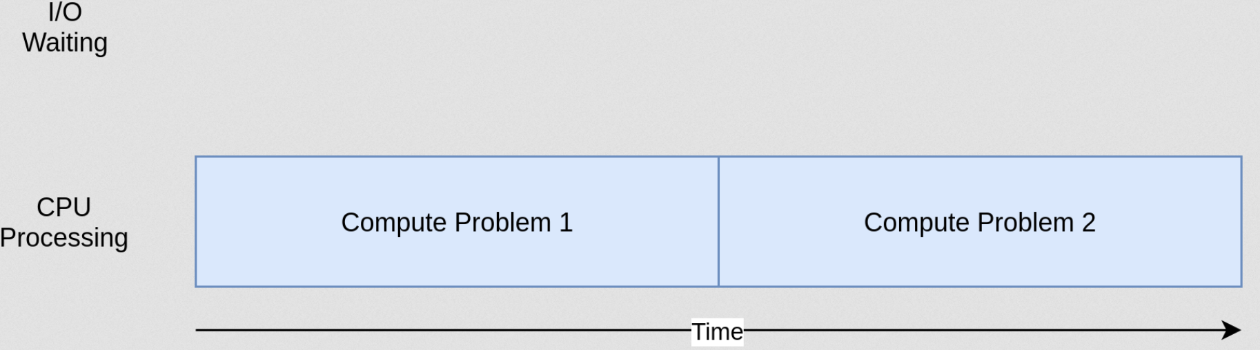
Multiprocessing vs Threading vs Asyncio (cont.)
CPU-bound vs I/O-bound
A CPU-bound process refers to the process at which the CPU’s most time is spent processing intensively (i.e., for intensive calculation).

Slide 299
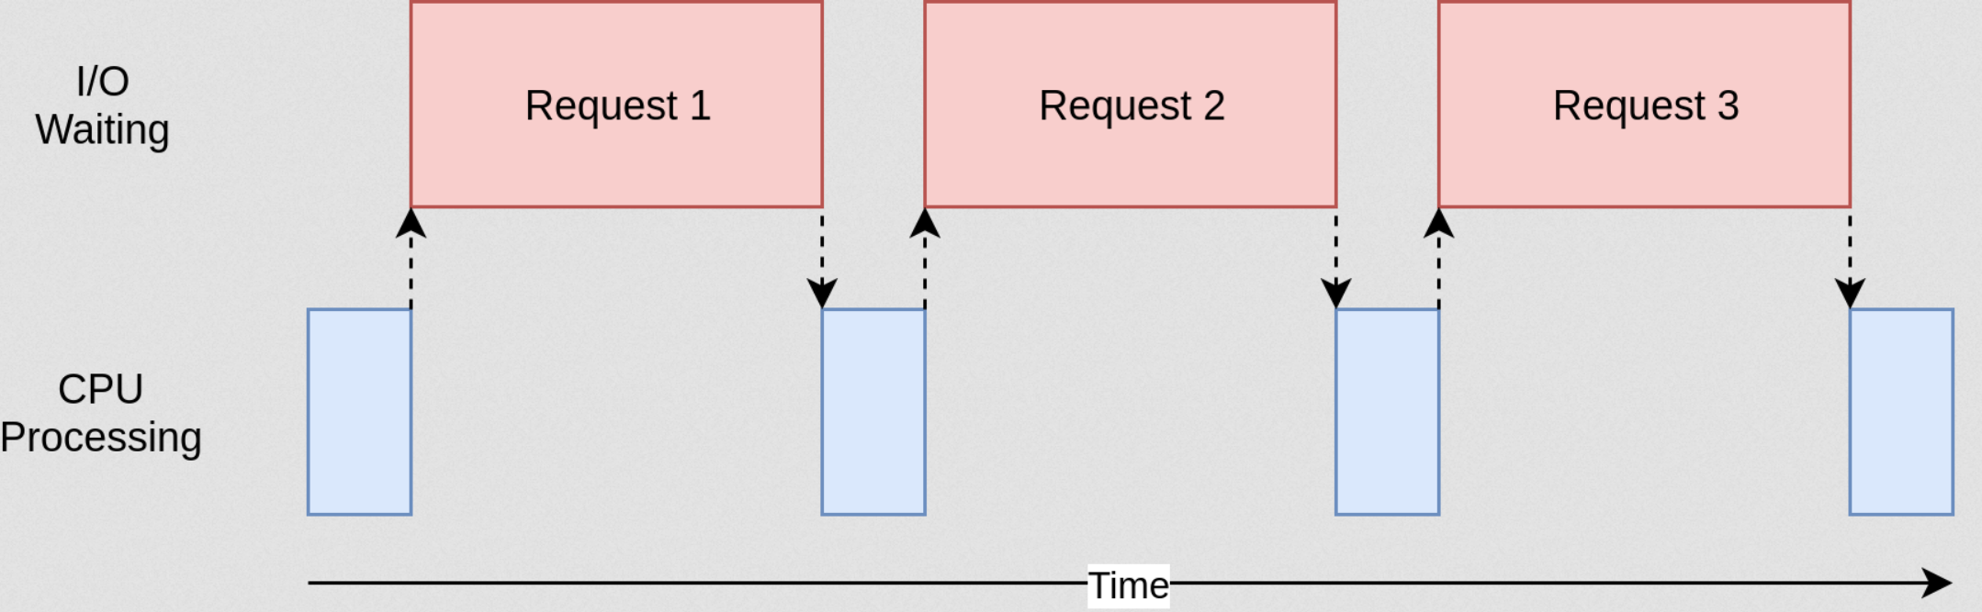
Multiprocessing vs Threading vs Asyncio (cont.)
CPU-bound vs I/O-bound (cont.)
An I/O-bound process refers to the process at which the CPU’s most time is spent idle waiting for some input to be received (i.e., waiting for an HTTP response).

Slide 300
Multiprocessing vs Threading vs Asyncio (cont.)
When to use which?
For a CPU-bound Python process, the best candidate to use is multiprocessing since it starts new processes taking advantage of CPU cores.
For an I/O bound Python process, the best candidate(s) to use is either threading or asyncio.
In case you have a fast I/O and a small number of tasks, you can use threading. In threading, the OS determines when switch contexts between threads. For a large number of threads, there can be a thread-management overhead.
In case you know exactly when to switch your program’s execution, you better use asyncio. asyncio gives you the ability to decide when/where to switch contexts between coroutines. All asyncio coroutines run as one thread. Programming with asyncio can be more challenging than if it’s done with threading.

Slide 301
Multiprocessing vs Threading vs Asyncio (cont.)
Summary
Module | multiprocessing | threading | asyncio
Purpose | Create processes | Create threads | Create coroutines
Use case | CPU-bound | Fast I/O-bound (limited number of connections) | Slow I/O-bound (many connections)
Number of threads | As many as each process starts | As many as you create | One thread
Number of threads effectively executing at a time | One thread per process | One thread | One thread

Slide 302
Multiprocessing vs Threading vs Asyncio (cont.)
multiprocessing
Executing Python code as three different processes
import multiprocessing
import time
def task(name):
print(f"{name} started")
time.sleep(1)
print(f"{name} finished")
def main():
p1 = multiprocessing.Process(target=task, args=("first task",))
p2 = multiprocessing.Process(target=task, args=("second task",))
p3 = multiprocessing.Process(target=task, args=("third task",))
p1.start(); p2.start(); p3.start()
p1.join(); p2.join(); p3.join()
if __name__ == "__main__":
main()

Slide 303
Multiprocessing vs Threading vs Asyncio (cont.)
threading
Executing Python code as three different threads
import threading
import time
def task(name):
print(f"{name} started")
time.sleep(1)
print(f"{name} finished")
def main():
t1 = threading.Thread(target=task, args=("first task",))
t2 = threading.Thread(target=task, args=("second task",))
t3 = threading.Thread(target=task, args=("third task",))
t1.start(); t2.start(); t3.start()
t1.join(); t2.join(); t3.join()
if __name__ == "__main__":
main()

Slide 304
Multiprocessing vs Threading vs Asyncio (cont.)
asyncio
Executing Python code as three coroutines
import asyncio
async def task(name):
print(f'{name} started')
await asyncio.sleep(1)
print(f'{name} finished')
async def main():
await asyncio.gather(
task('first task'),
task('second task'),
task('third task'),
)
if __name__ == '__main__':
asyncio.run(main())

Slide 305
Extra Stuff
Python “-i” option
If have written several lines of code and you made a mistake, it might be tedious to rewrite the whole thing in the Python interpreter.
You can create a file and run it interactively as follows:
l = [1, 2, 3, 4, 5]
n = 5
def multiply_list(l, n):
for i in range(len(l)):
l[i] = l[i] * n
return l
You can create a file and run it interactively as follows:
python -i test1.py
>>> multiply_list(l, n)
[5, 10, 15, 20, 25]
>>>

Slide 306
Extra Stuff
Python “-c” option
You can execute Python code through command line as follows:
python -c 'name = input("Enter your name: "); print("Hello,", name)'
Make sure that you have the Python code enclosed by quotes.

Slide 307
Extra Stuff
Python “-m” option
You can run modules directly from command line as we’ve done when creating virtual environments using venv module
compileall module can be used to compile modules to pycache
python -m compileall mymodule.py
Compiling 'mymodule.py'...
cProfile module is used to calculate the total running time and total function calls
python -m cProfile mymodule.py
13 function calls in 0.000 seconds
Ordered by: standard name
...
http.server module is used to calculate the total running time and total function calls
python3 -m http.server --bind 127.0.0.1
Serving HTTP on 127.0.0.1 port 8000 (http://127.0.0.1:8000/) ...

Slide 308

Extra Stuff
Walrus operator
:= (since Python 3.8)
parentheses are mandatory.
x = 0
while (x := x+1) < 5:
print(f"{x} is less than 5")
1 is less than 5
2 is less than 5
3 is less than 5
4 is less than 5
Output

Slide 309
Extra Stuff
Walrus operator (cont.)
:= (since Python 3.8)
parentheses are mandatory.
with open("data.bin", "rb") as f:
while (chunk := f.read(100)):
print(chunk)

Slide 310
Extra Stuff
repr function
When debugging code, you probably want to use repr within the print.
Shows you more info about a value and its type.
>>> text = "Test\n\nValue"
>>> print(text)
Test
Value
>>> print(repr(text))
'Test\n\nValue'

Slide 311
Coding Styles
Use spaces around operators and after commas, but not directly inside bracketing constructs
a = f(1, 2) + g(3, 4)
“Use docstrings”
“Wrap lines so that they don’t exceed 79 characters.”
“Name your classes and functions consistently; the convention is to use UpperCamelCase for classes and lowercase_with_underscores for functions and methods. Always use self as the name for the ﬁrst method argument.”
Rest of them here - you don’t have to follow every single thing 🙃

Slide 312
What’s next?
Pick an idea and start your first project in Python.
Hint: there are many frameworks that can help you do cool stuff 😃
If you’d like more practice, try to join competitive programming platforms such as the following:
LeetCode
HackerRank
Codewars
I hope you enjoyed the ride 😄
If you’d like to contact me for whatever reason, you can find me on Twitter @D4rkness_14

